Slide 1
ALPASS
Automated Layout Process Approval and Scrutiny System

Slide 2
Brief process flow of Section 50
Pre-requisites: Registered Applicant and Consultant in the ALPASS Portal
Login with the valid consultant and providing reference of the Applicant
Filling Basic information of the Layout Application and generating Application Number
Submission of Mandatory Documents and Shape file of the Outer Boundary of the Layout Plan
Providing Applicant’s consent via Mobile OTP and forwarding Application to Department

Slide 3
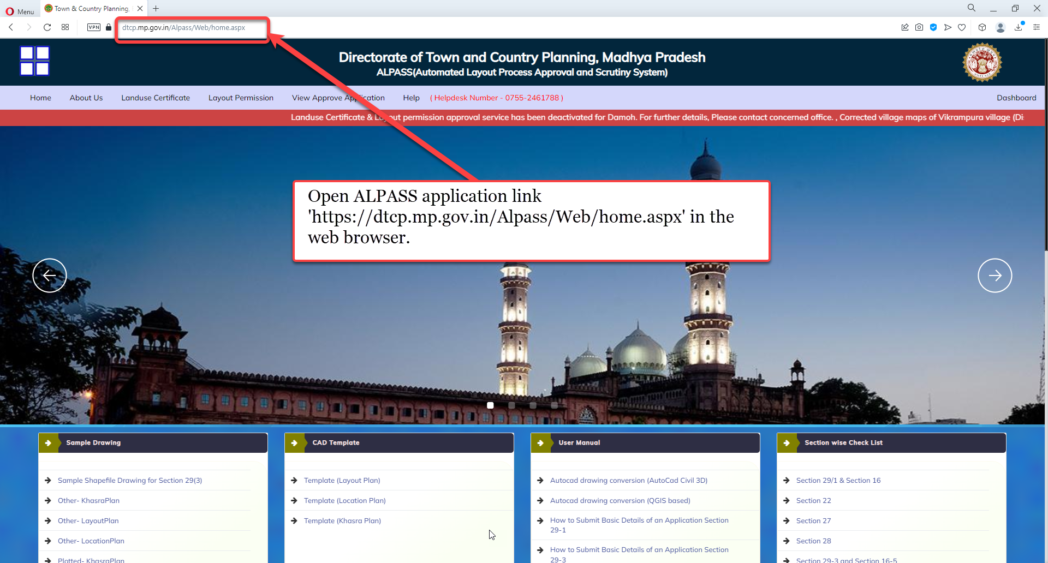
Open ALPASS application link 'https://dtcp.mp.gov.in/Alpass/Web/home.aspx' in the web browser.

Slide 4
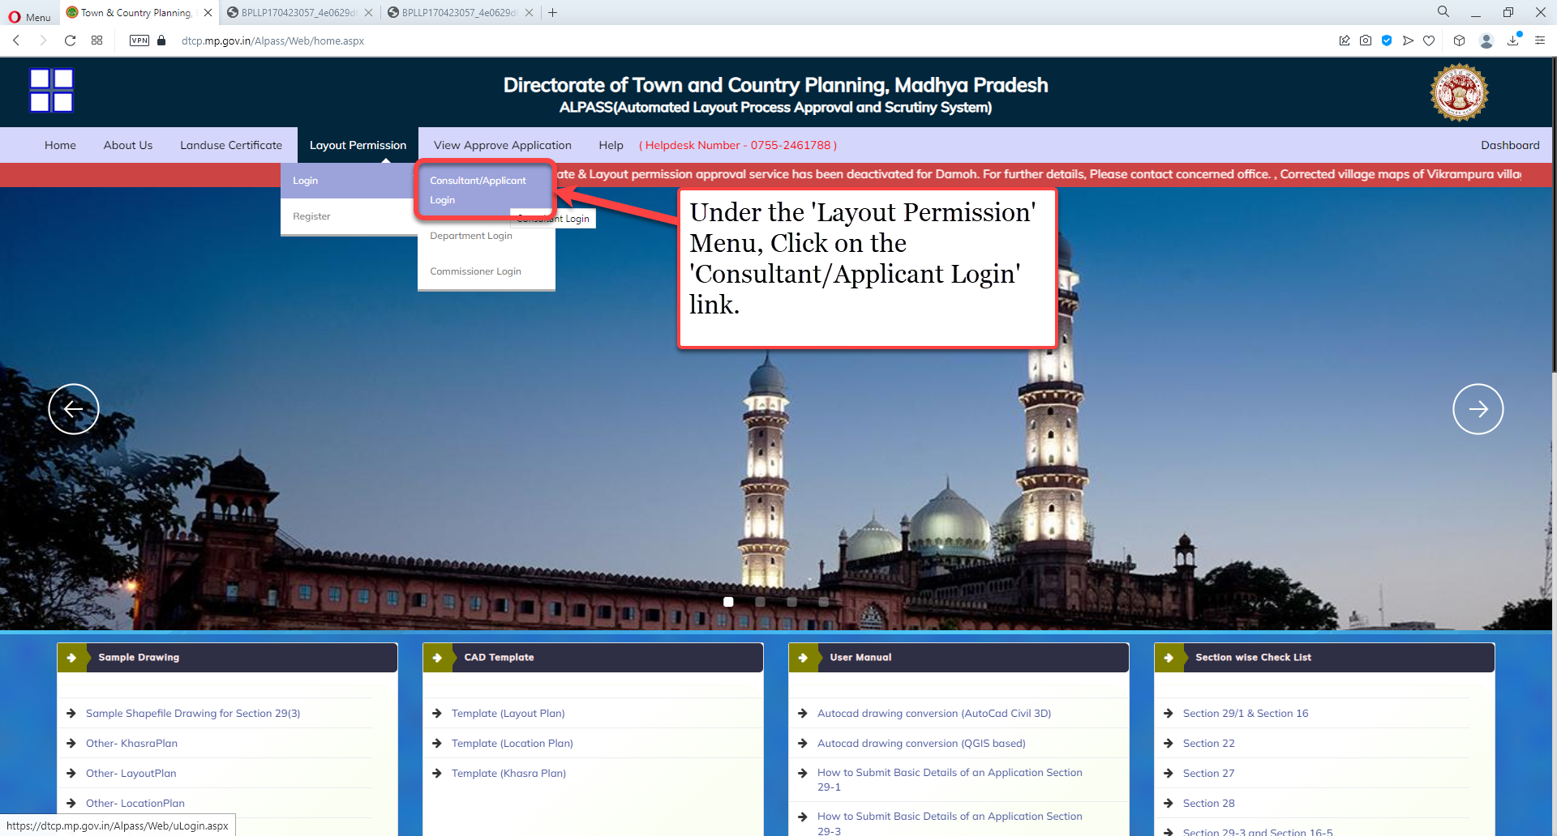
Under the 'Layout Permission' Menu, Click on the 'Consultant/Applicant Login' link.

Slide 5
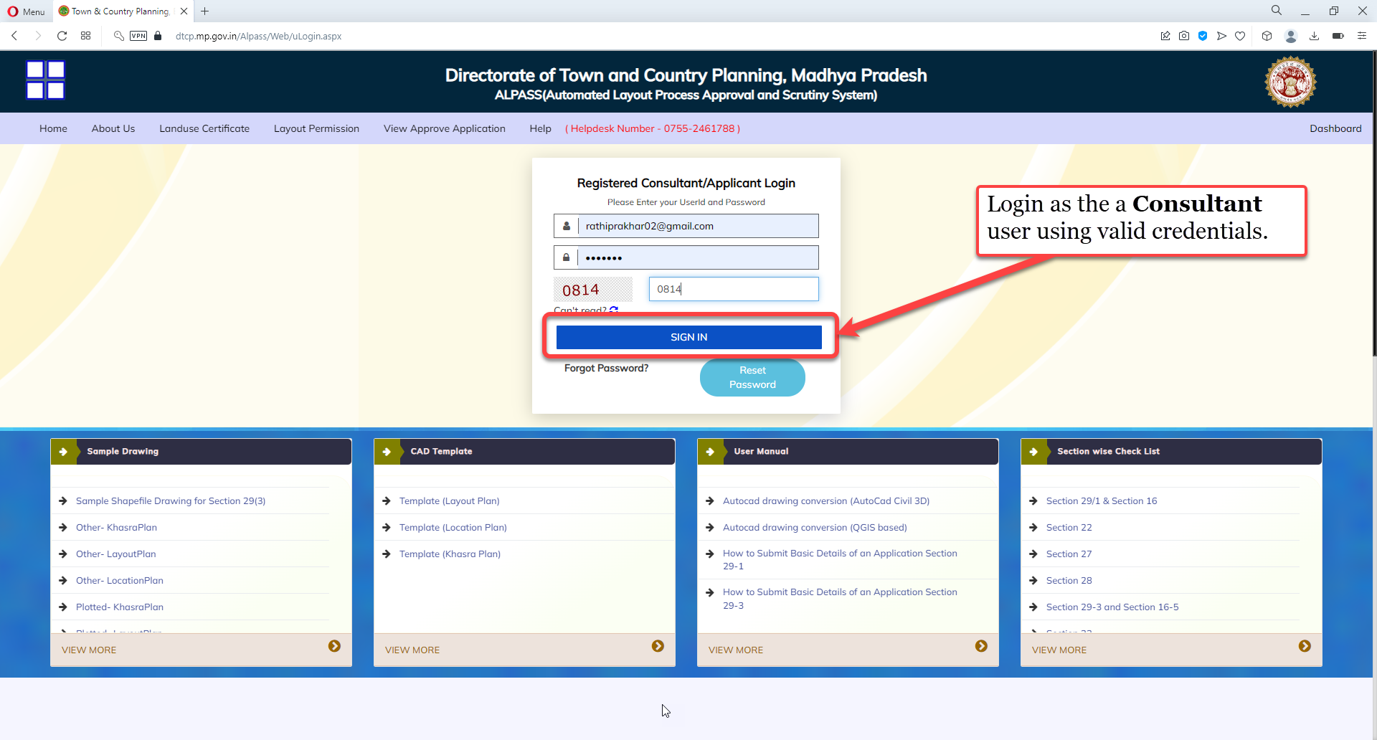
Under the 'Layout Permission' Menu, Click on the 'Consultant/Applicant Login' link.

Slide 6
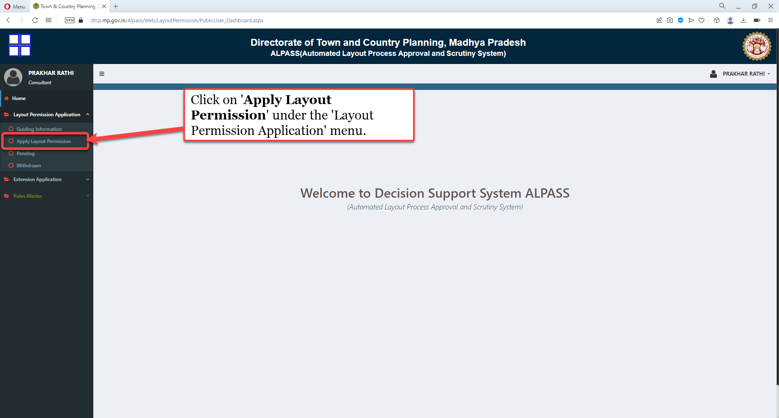
Click on 'Apply Layout Permission' under the 'Layout Permission Application' menu.

Slide 7
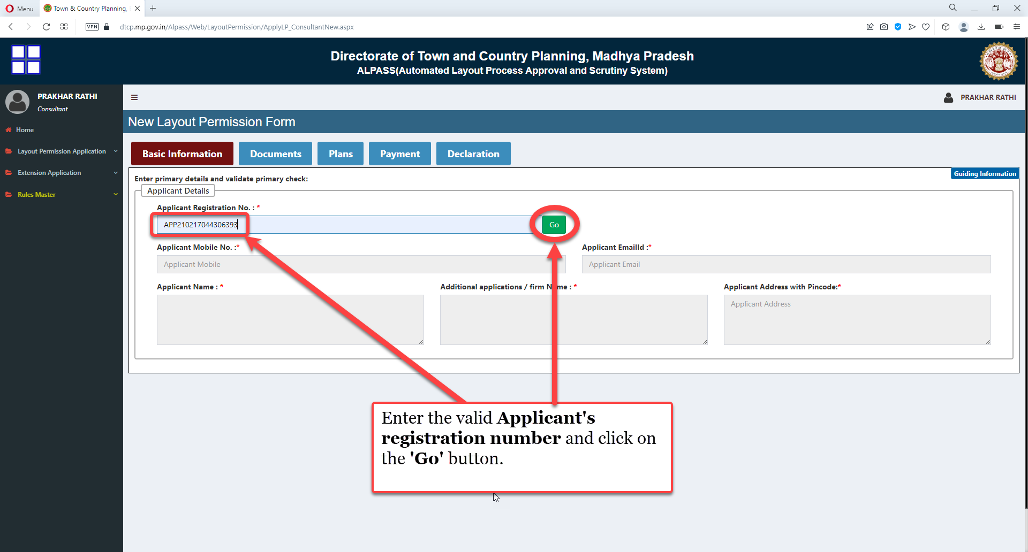
Enter the valid Applicant's registration number and click on the 'Go' button.

Slide 8
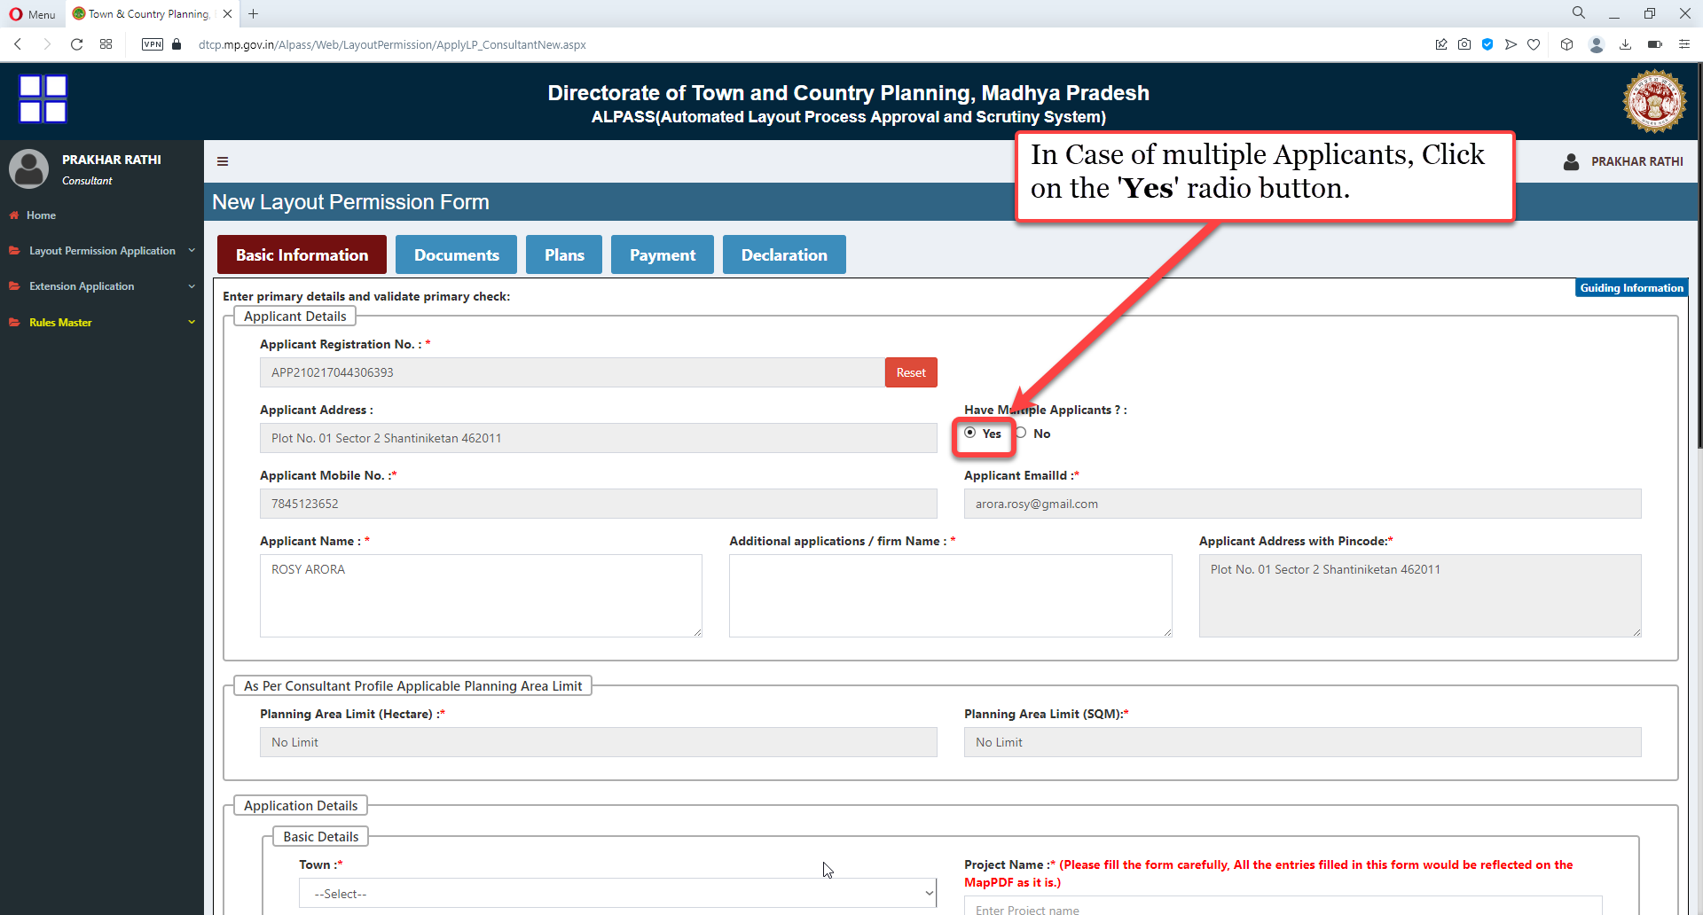
In Case of multiple Applicants, Click on the 'Yes' radio button

Slide 9
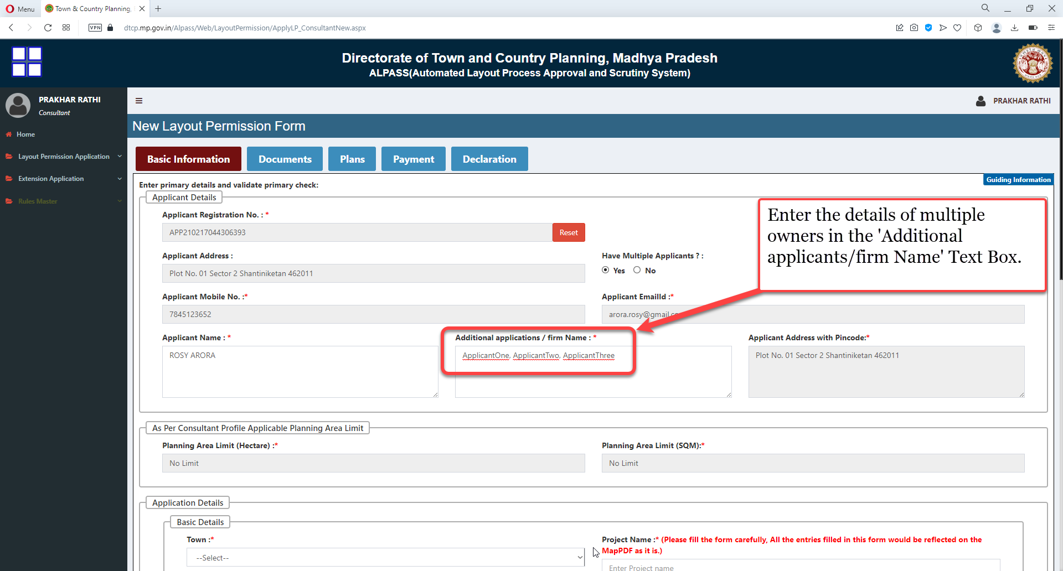
Enter the details of multiple owners in the 'Additional applicants/firm Name' Text Box.

Slide 10
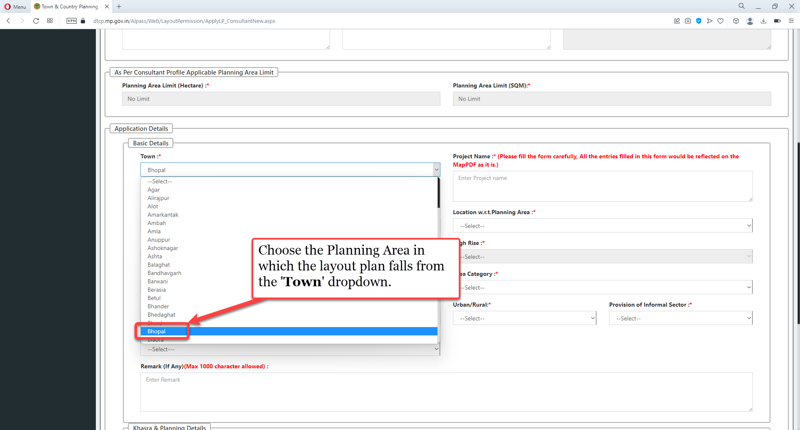
Choose the Planning Area in which the layout plan falls from the 'Town' dropdown.

Slide 11
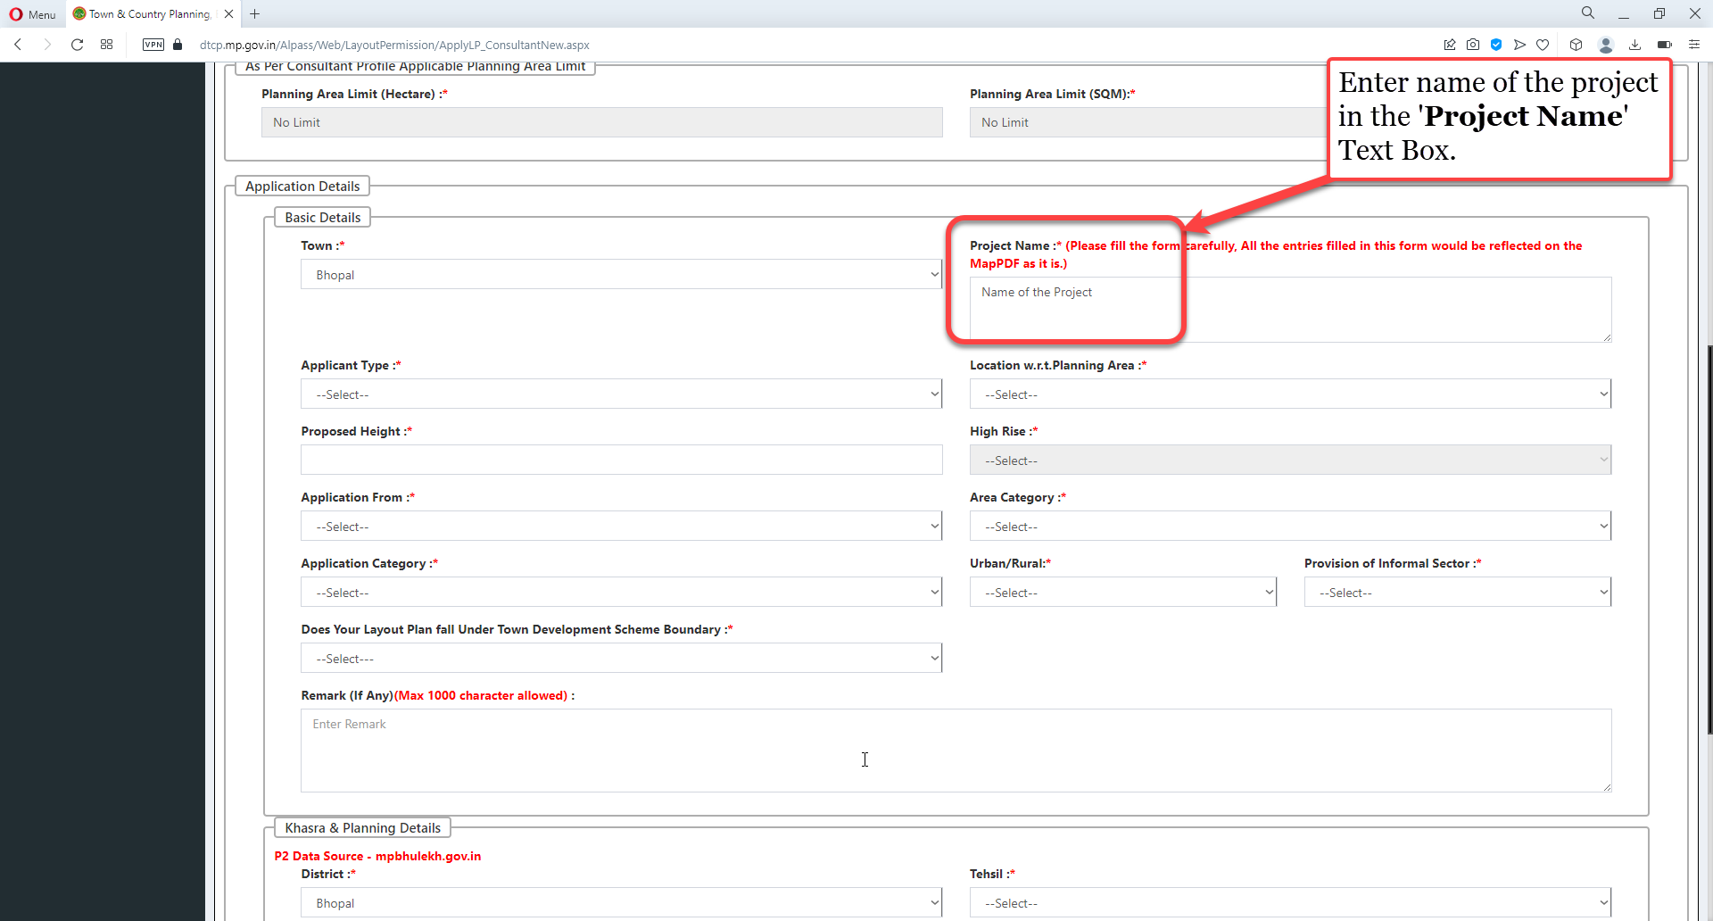
Enter name of the project in the 'Project Name' Text Box.

Slide 12
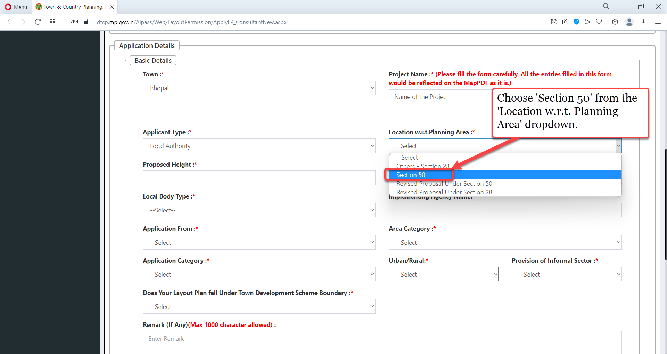
Choose 'Section 50' from the 'Location w.r.t. Planning Area' dropdown

Slide 13
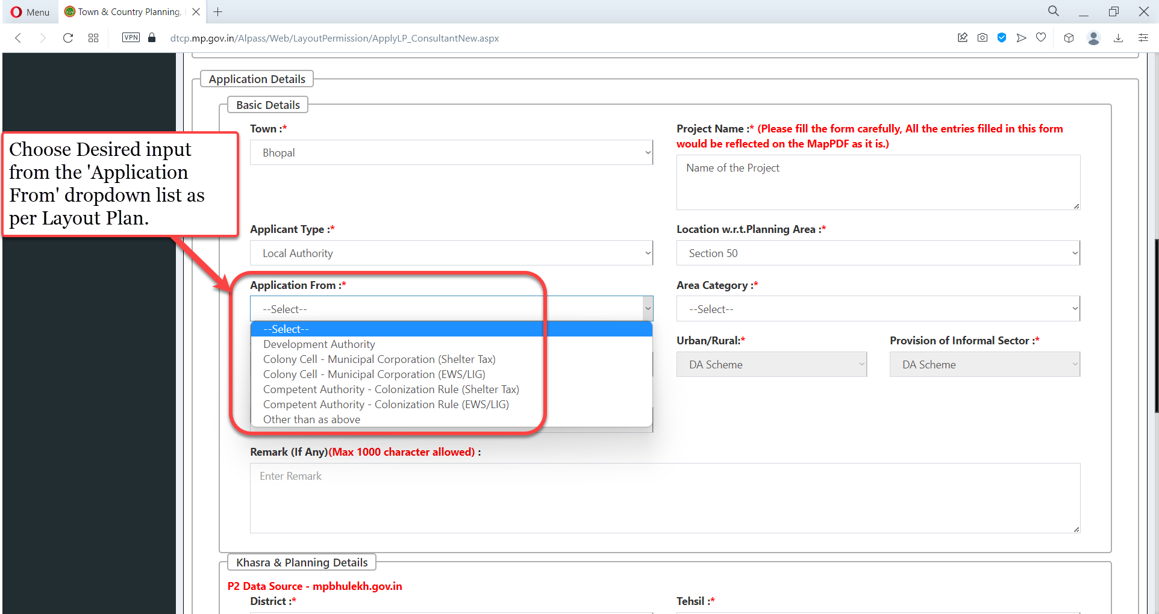
Choose Desired input from the 'Application From' dropdown list as per Layout Plan

Slide 14
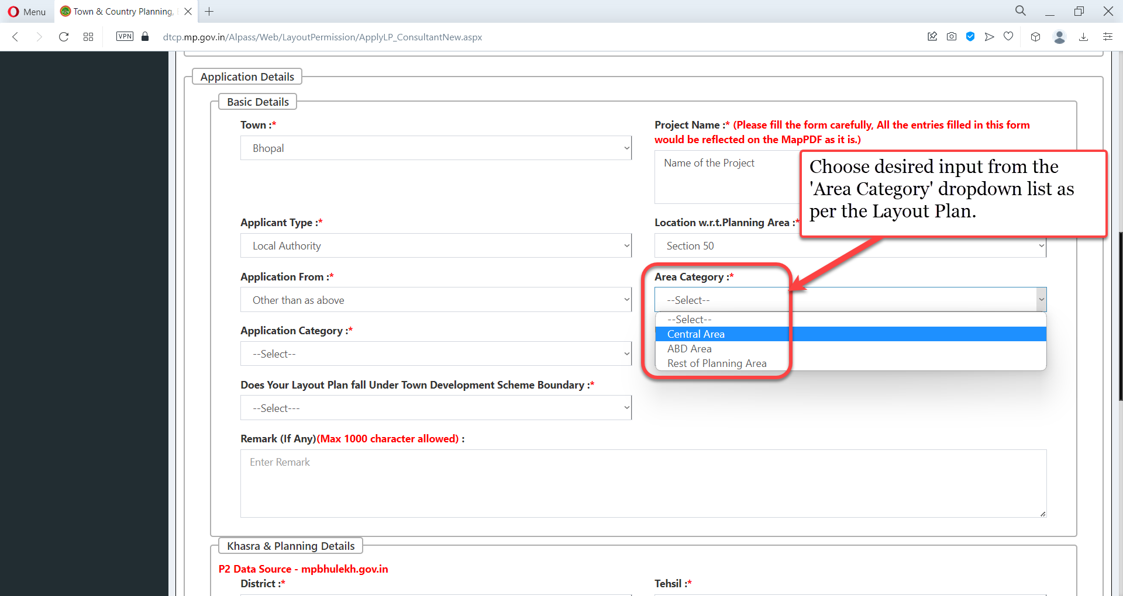
Choose desired input from the 'Area Category' dropdown list as per the Layout Plan

Slide 15
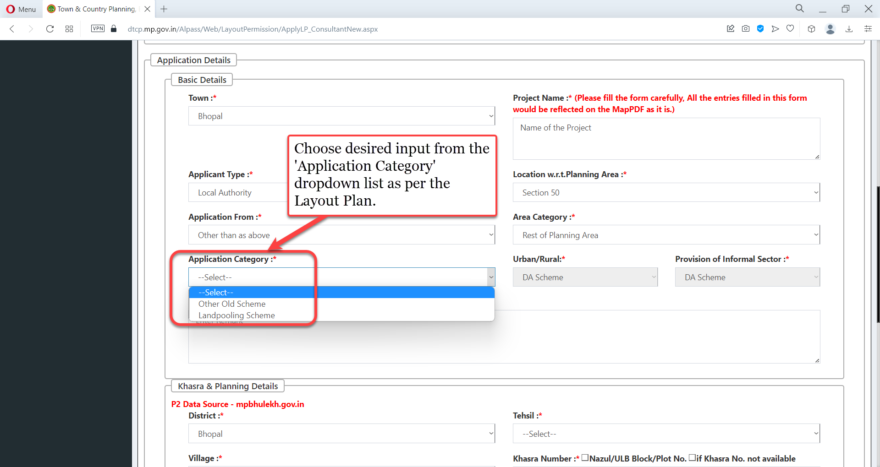
Choose desired input from the 'Application Category' dropdown list as per the Layout Plan.

Slide 16
Choose the desired value from the 'Area Category' dropdown list as per the Layout Plan

Slide 17
Choose desired input from the 'Application Category' dropdown list as per the Layout Plan

Slide 18
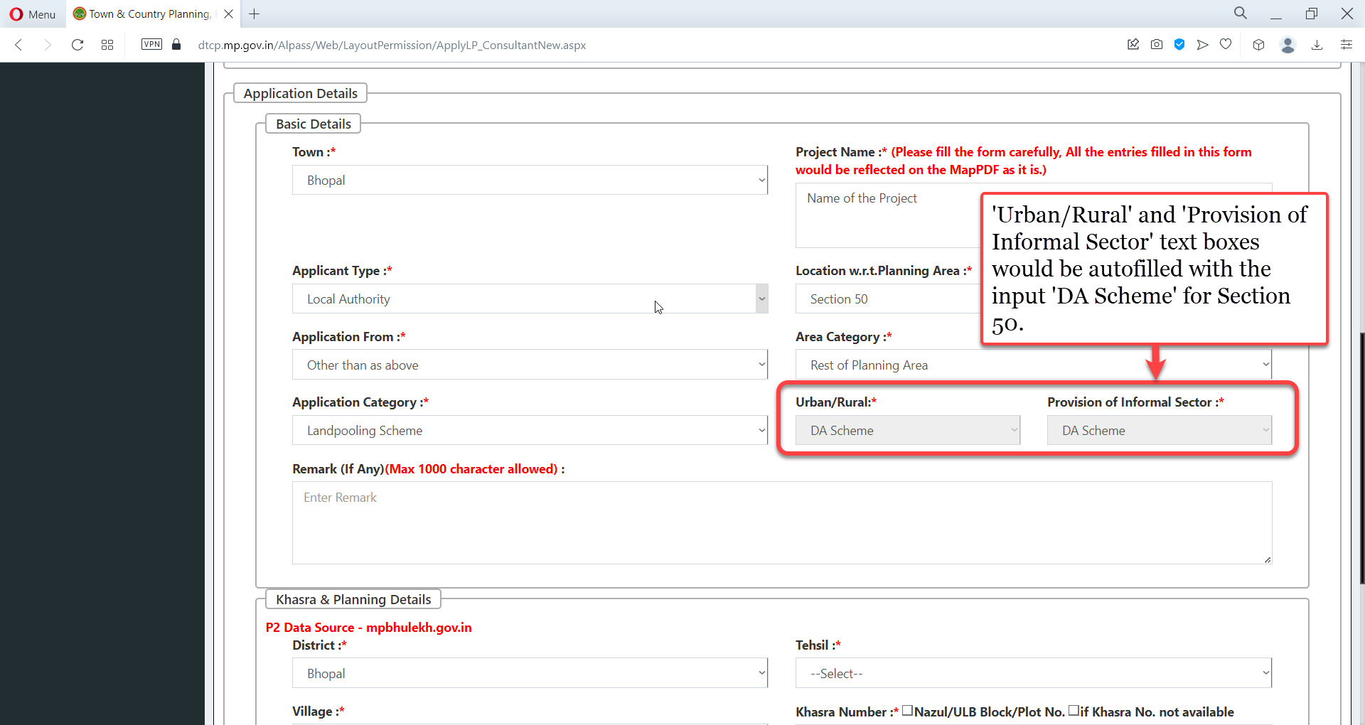
'Urban/Rural' and 'Provision of Informal Sector' text boxes would be auto filled with the input 'DA Scheme' for Section 50

Slide 19
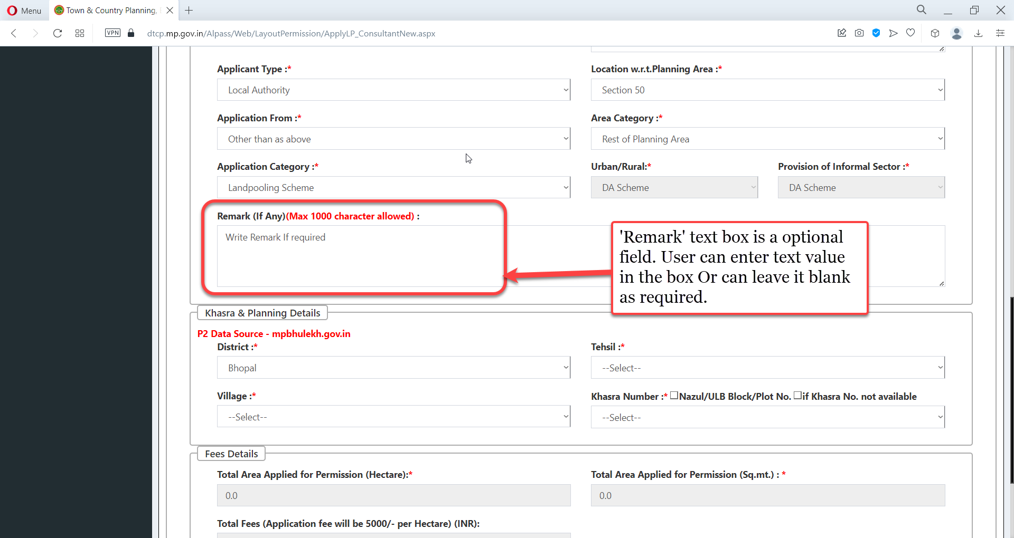
'Remark' text box is a optional field. User can enter text value in the box Or can leave it blank as required

Slide 20
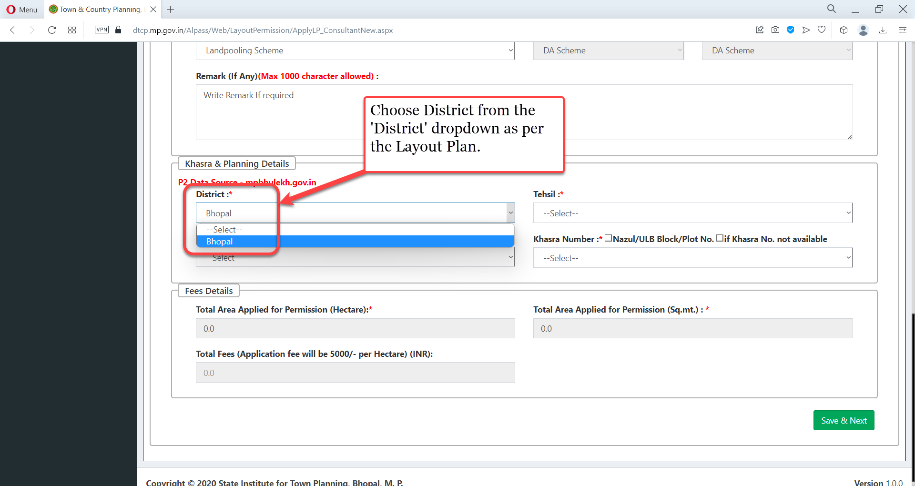
Choose District from the 'District' dropdown as per the Layout Plan

Slide 21
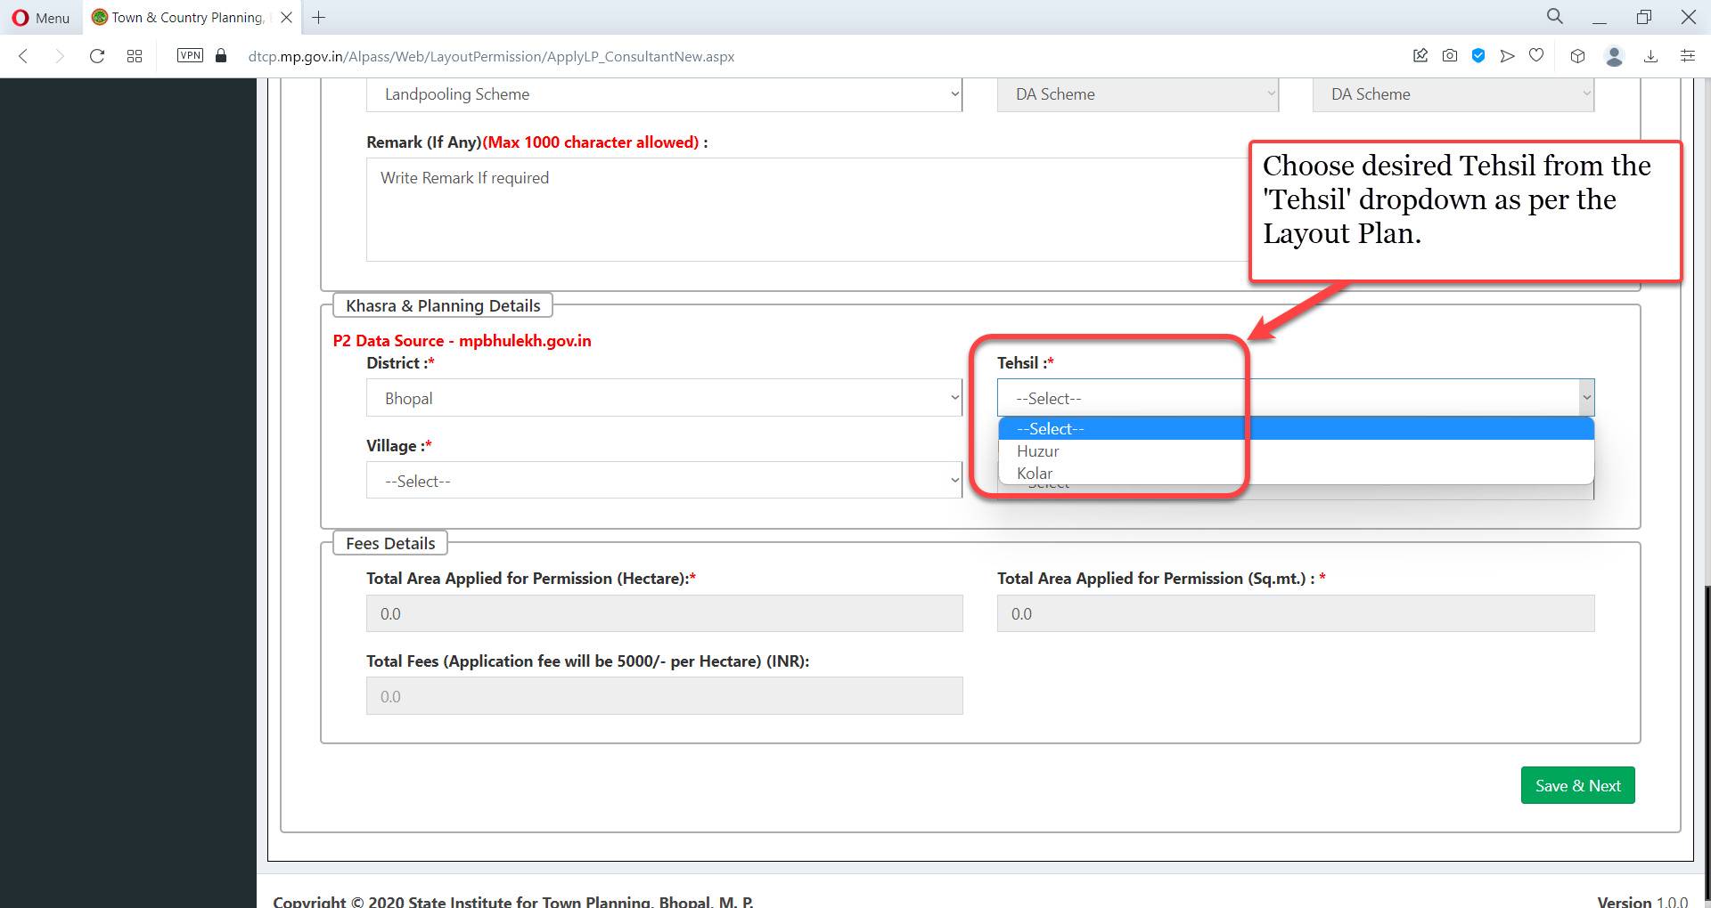
Choose desired Tehsil from the 'Tehsil' dropdown as per the Layout Plan.

Slide 22
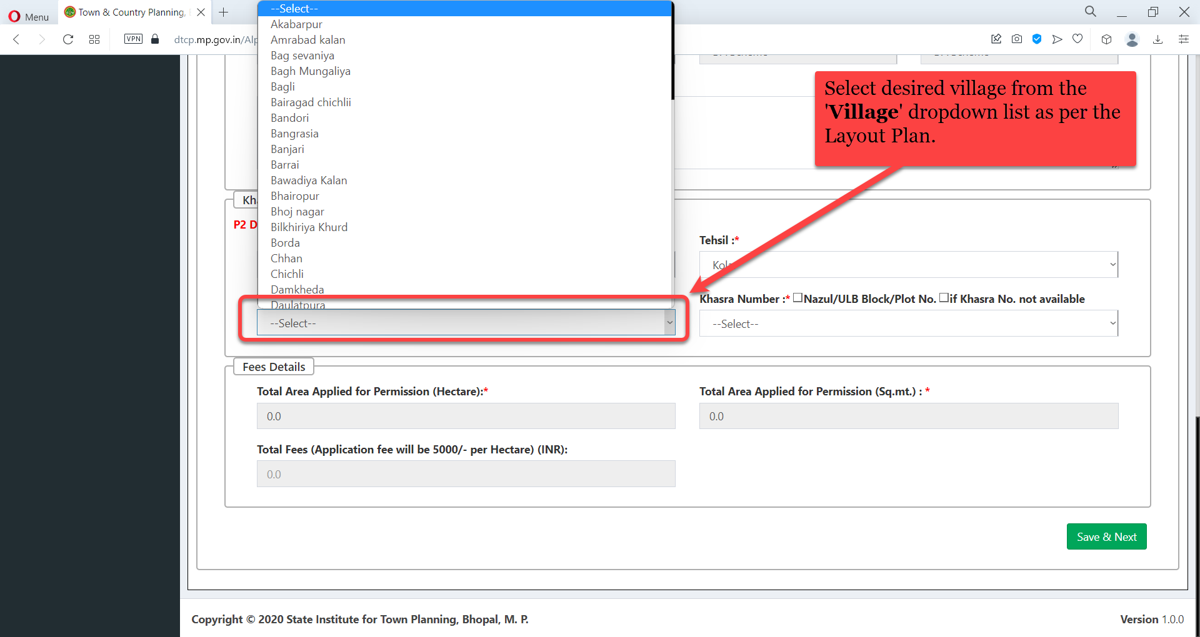
Select desired village from the 'Village' dropdown list as per the Layout Plan

Slide 23
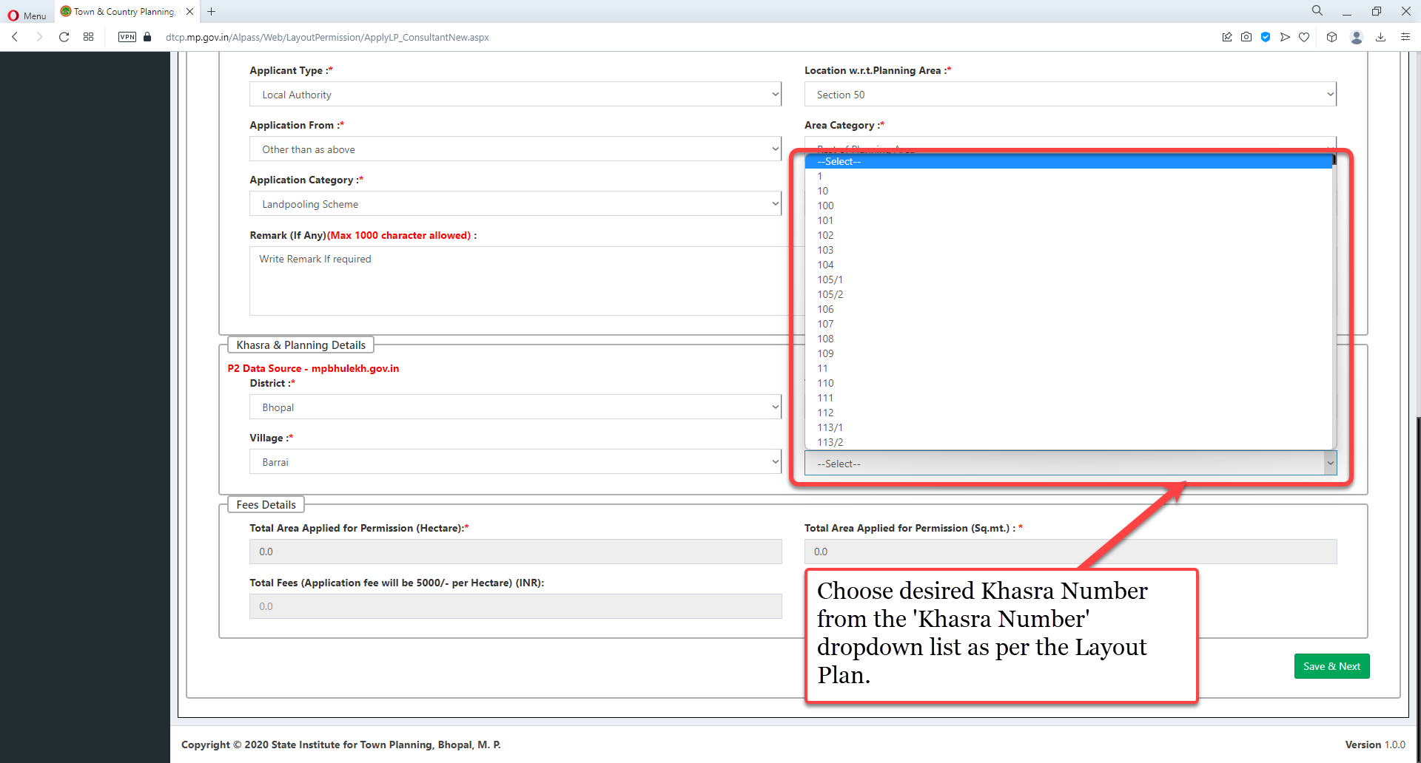
Choose desired Khasra Number from the 'Khasra Number' dropdown list as per the Layout Plan

Slide 24
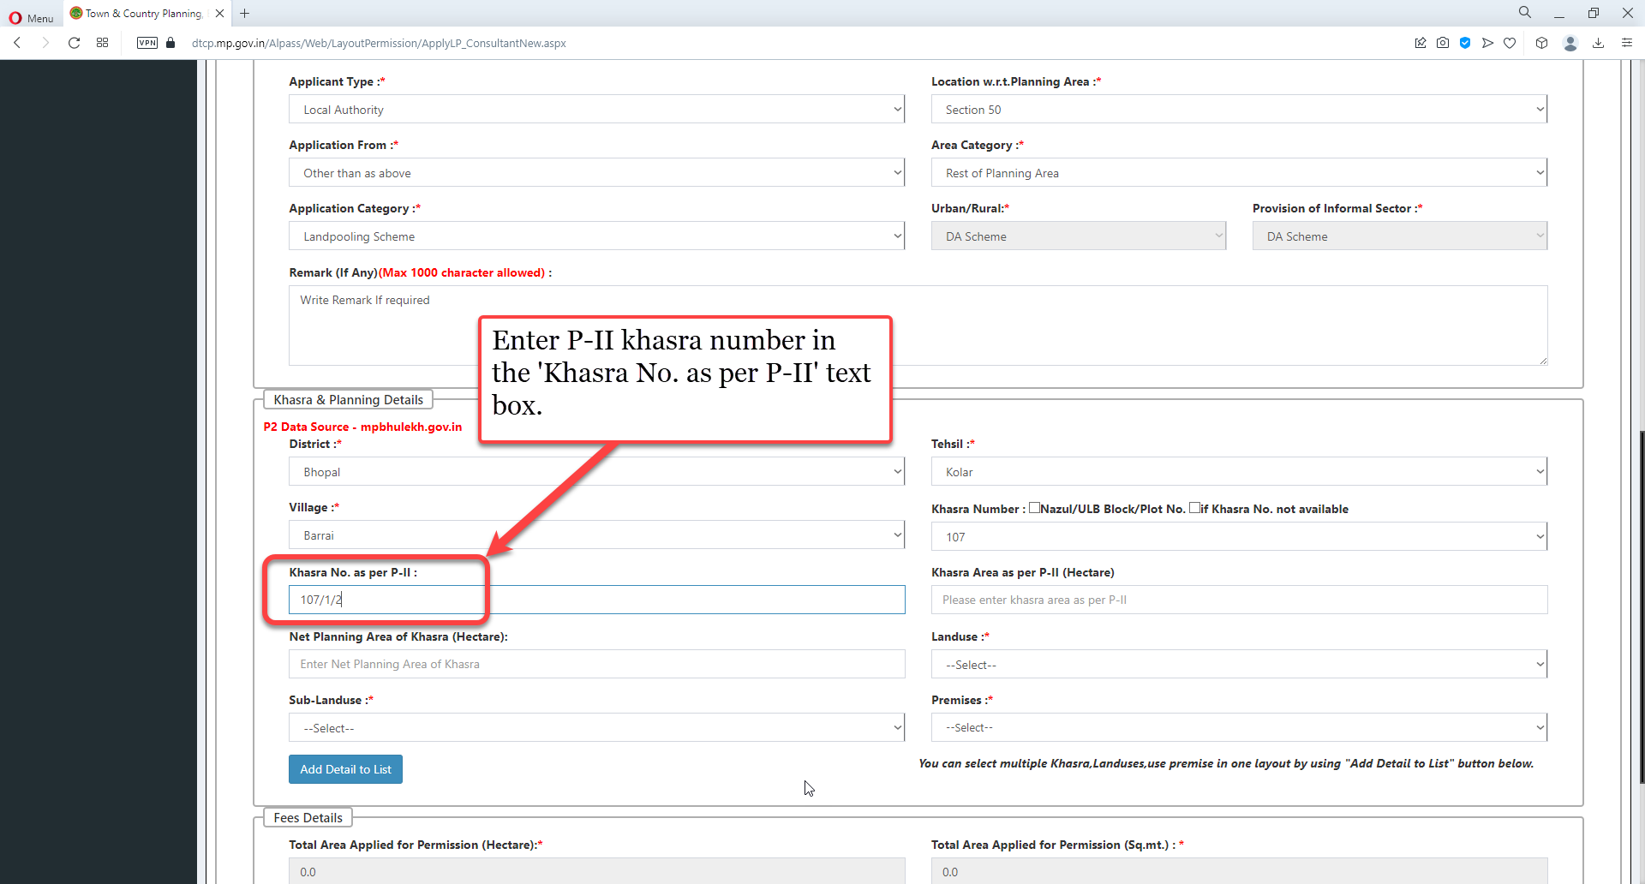
Enter P-II khasra number in the 'Khasra No. as per P-II' text box

Slide 25
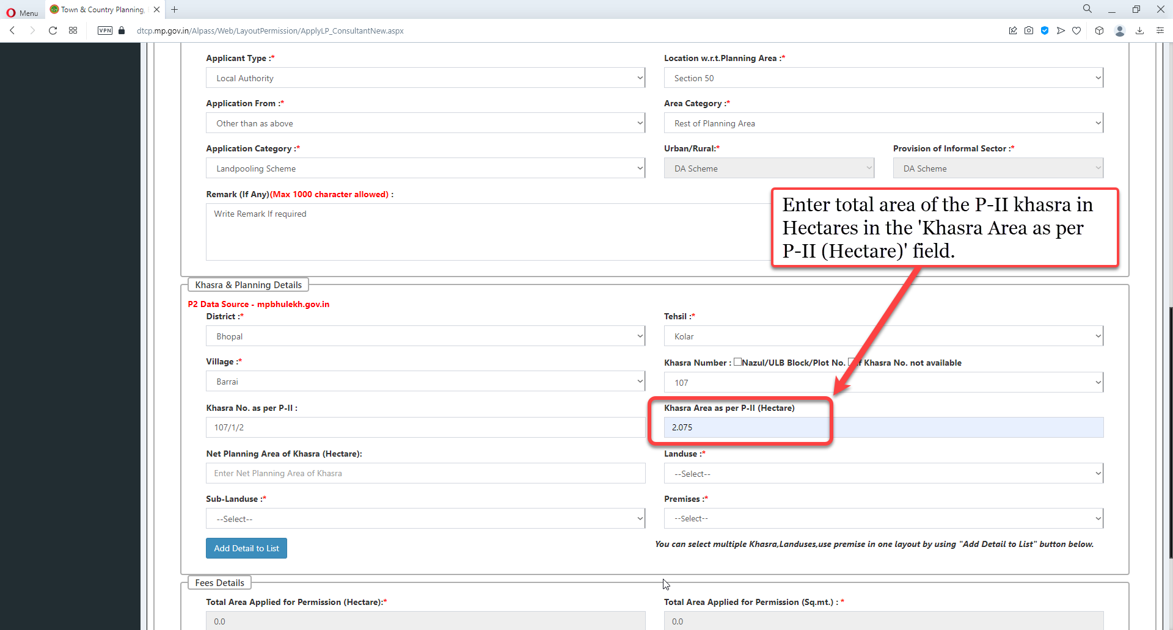
Enter total area of the P-II khasra in Hectares in the 'Khasra Area as per P-II (Hectare)' field

Slide 26
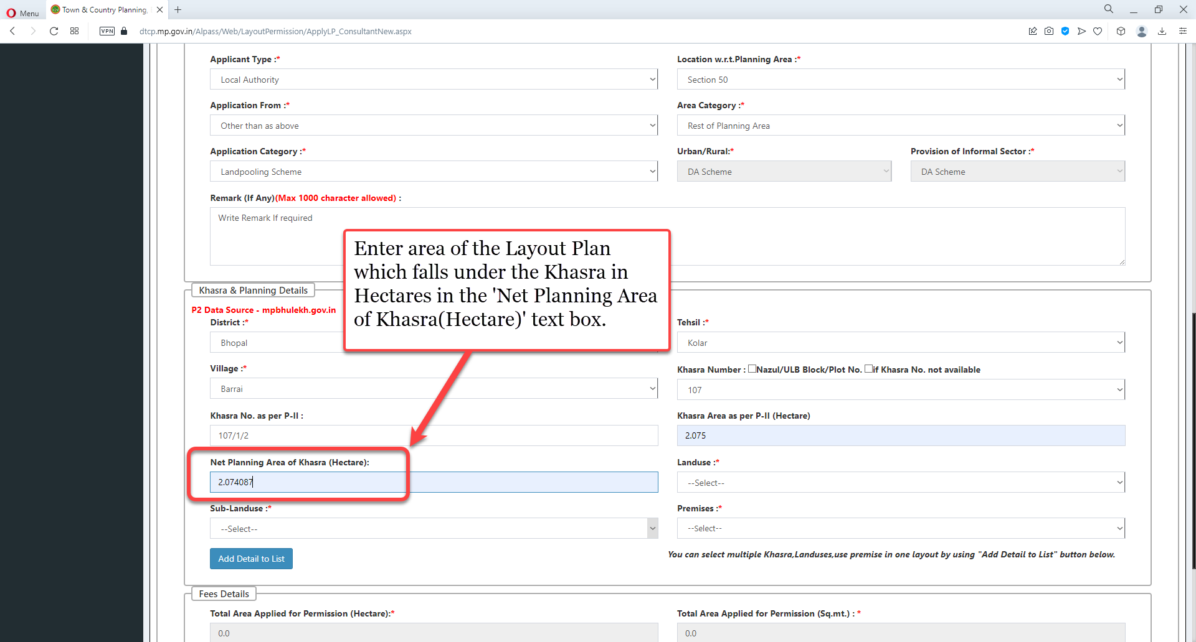
Enter area of the Layout Plan which falls under the Khasra in Hectares in the 'Net Planning Area of Khasra(Hectare)' text box

Slide 27
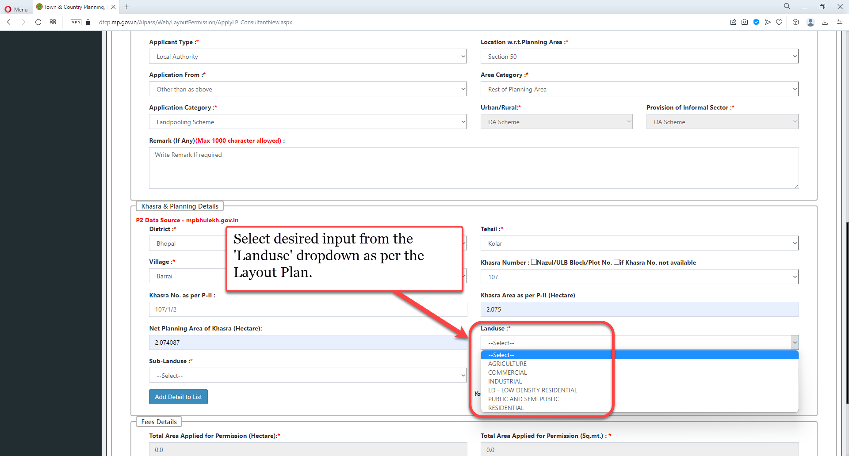
Select desired input from the 'Landuse' dropdown as per the Layout Plan

Slide 28
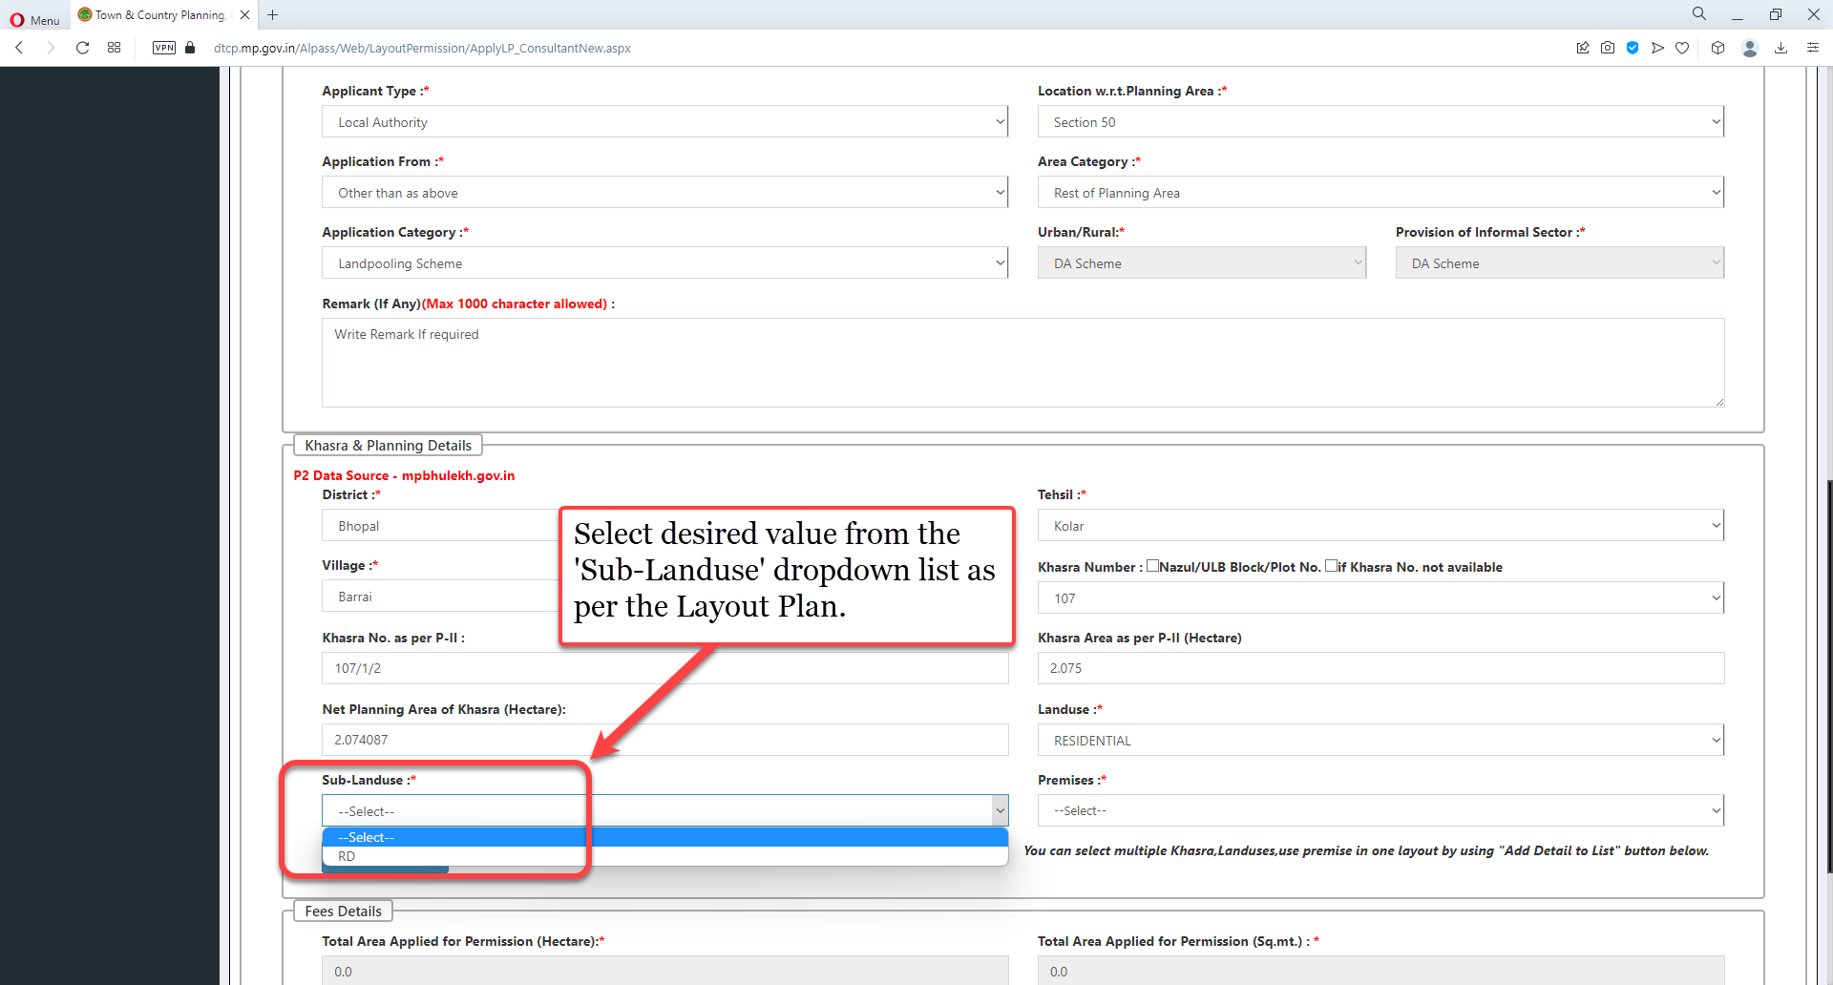
Select desired value from the 'Sub-Landuse' dropdown list as per the Layout Plan

Slide 29
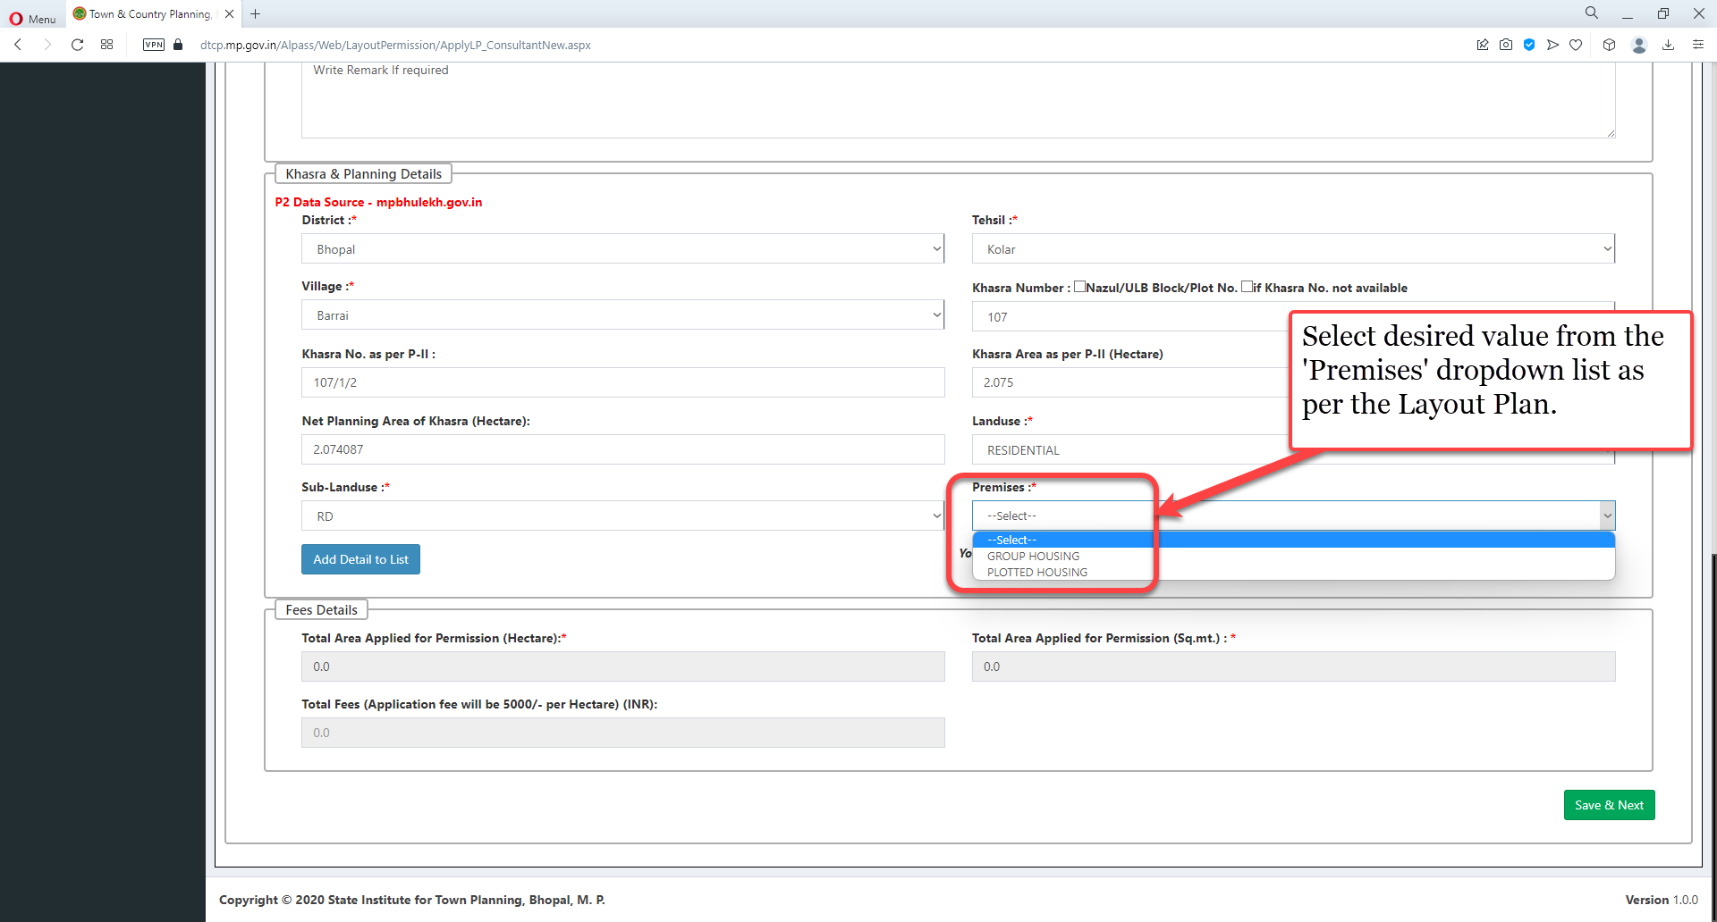
Select desired value from the 'Premises' dropdown list as per the Layout Plan

Slide 30
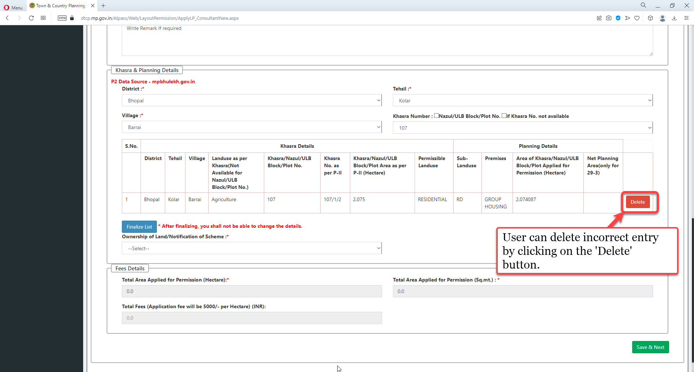
User can delete incorrect entry by clicking on the 'Delete' button

Slide 31
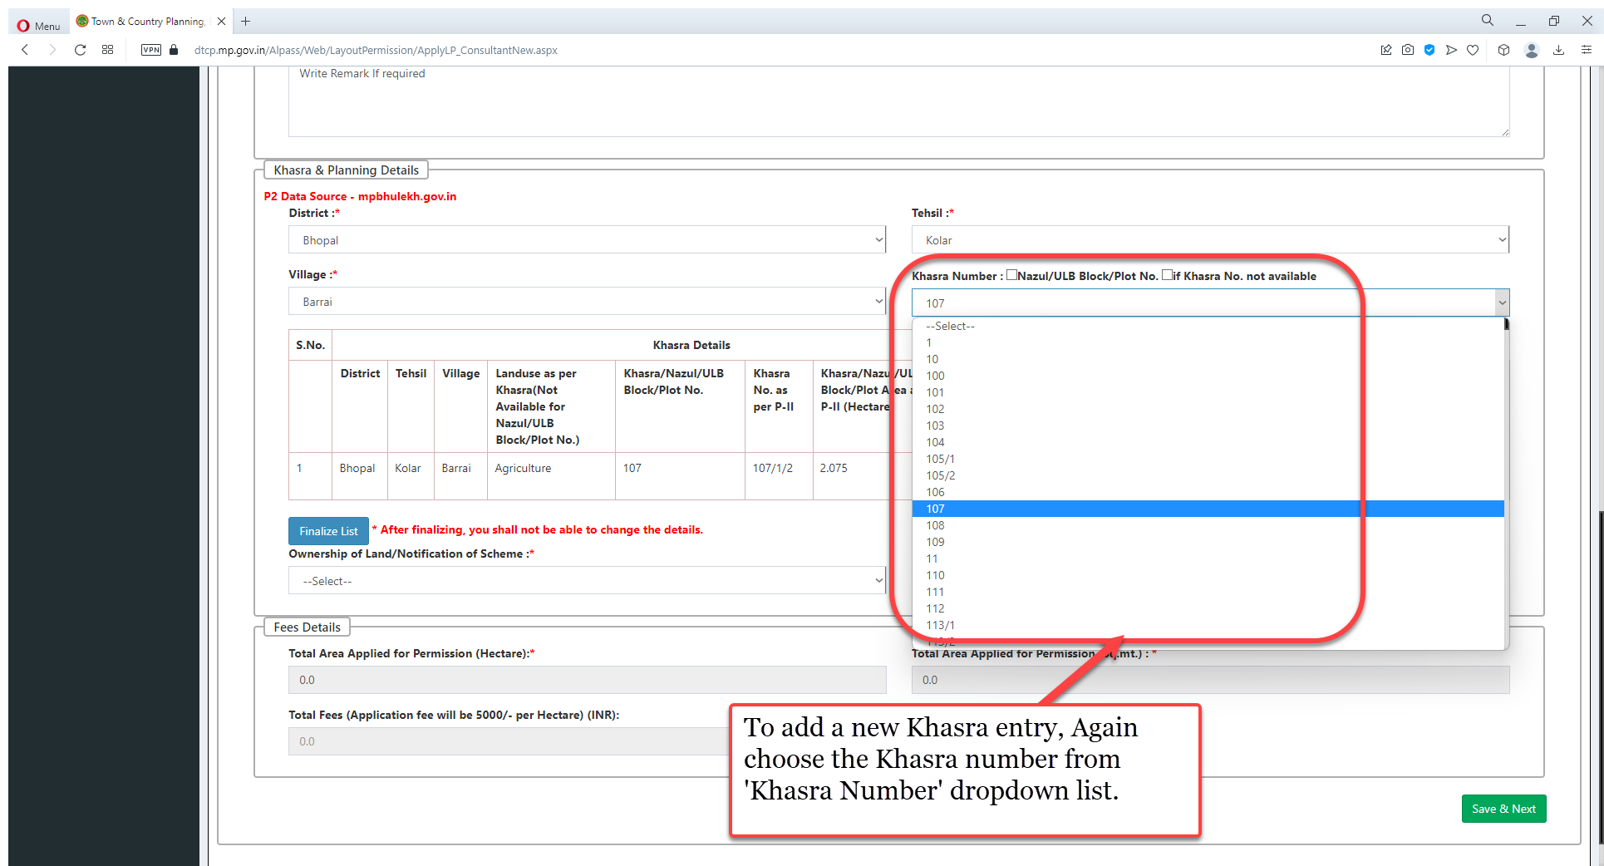
To add a new Khasra entry, again choose the Khasra number from 'Khasra Number' dropdown list

Slide 32
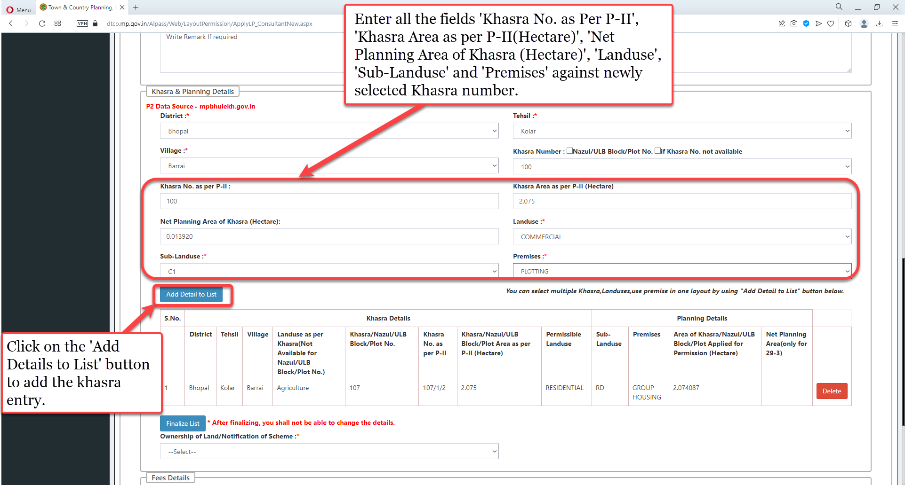
Enter all the fields 'Khasra No. as Per P-II', 'Khasra Area as per P-II(Hectare)', 'Net Planning Area of Khasra (Hectare)', 'Landuse', 'Sub-Landuse' and 'Premises' against newly selected Khasra number. Click on the 'Add Details to List' button to add the khasra entry

Slide 33
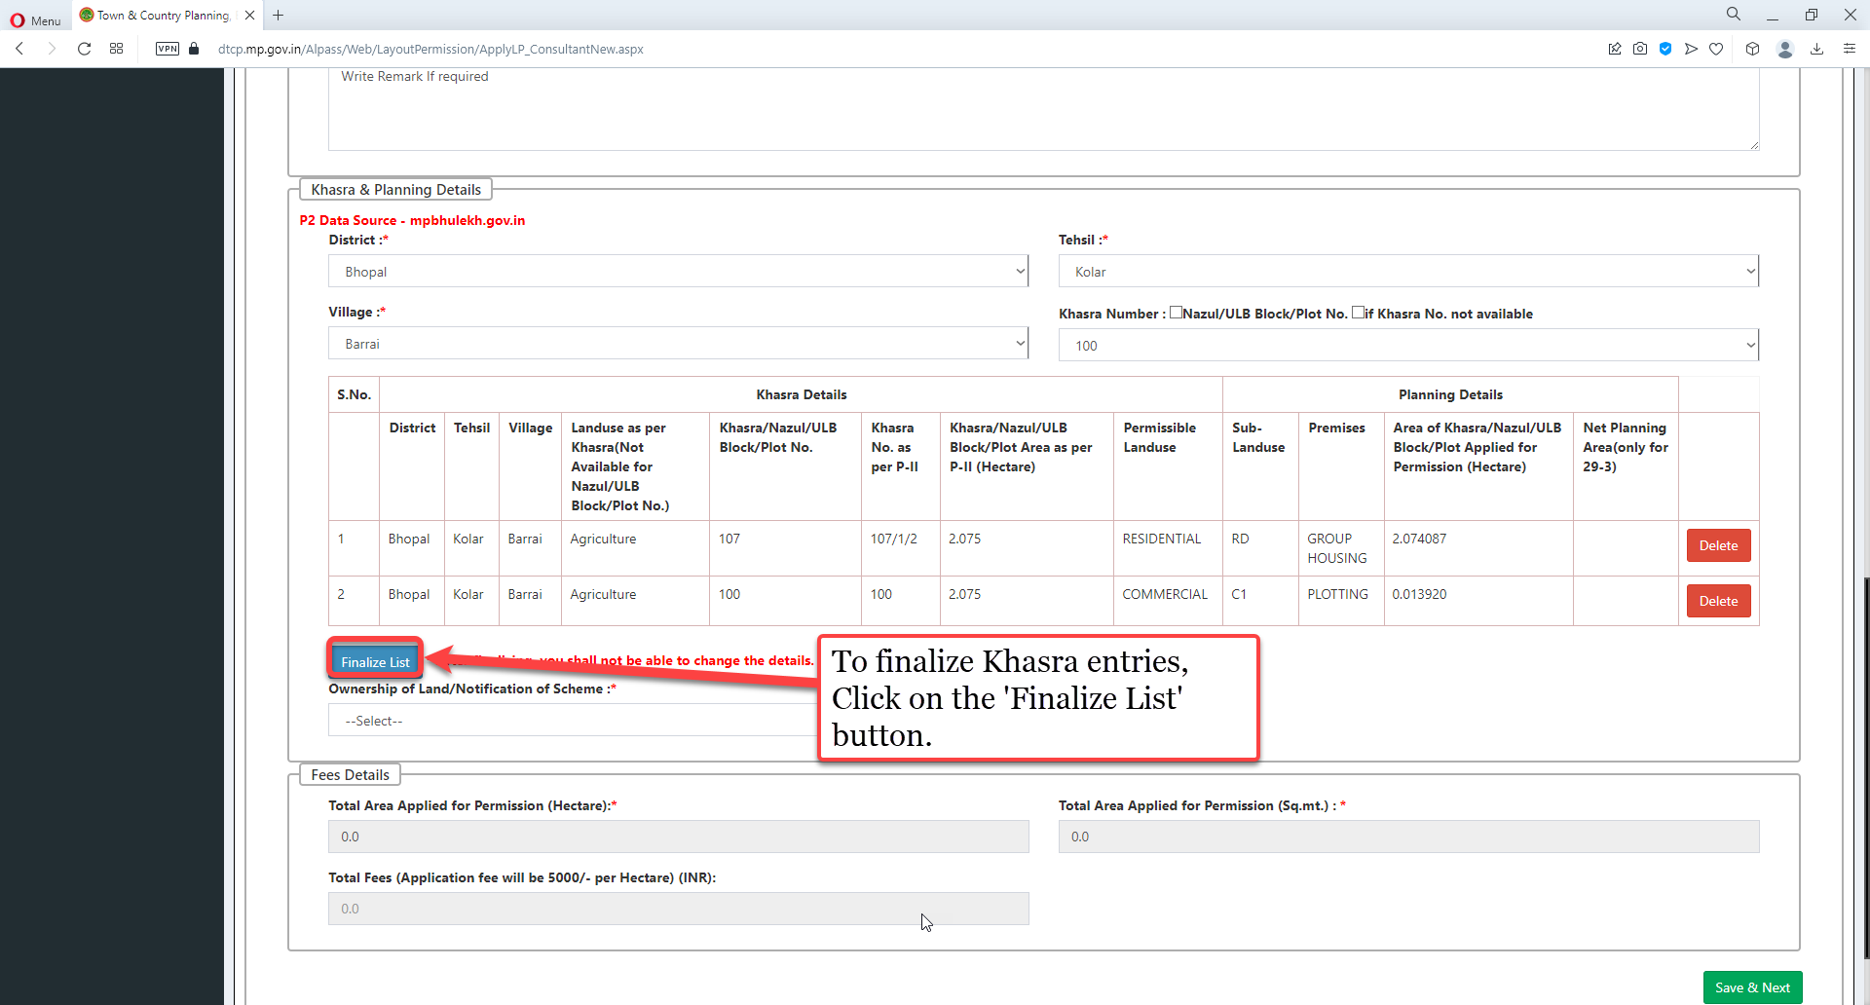
To finalize Khasra entries, click on the 'Finalize List' button

Slide 34
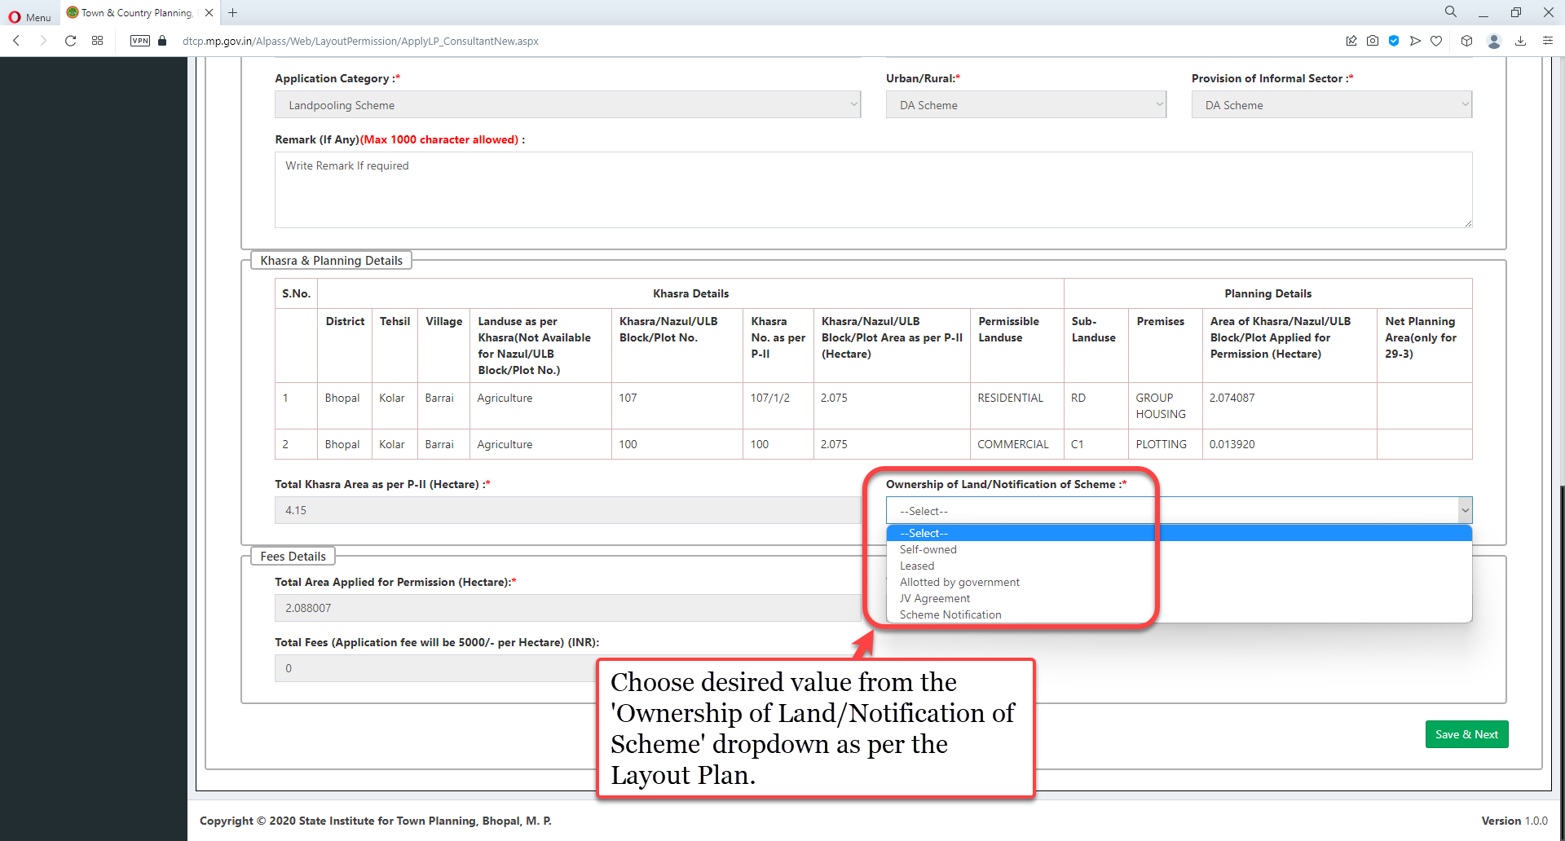
Choose desired value from the 'Ownership of Land/Notification of Scheme' dropdown as per the Layout Plan

Slide 35
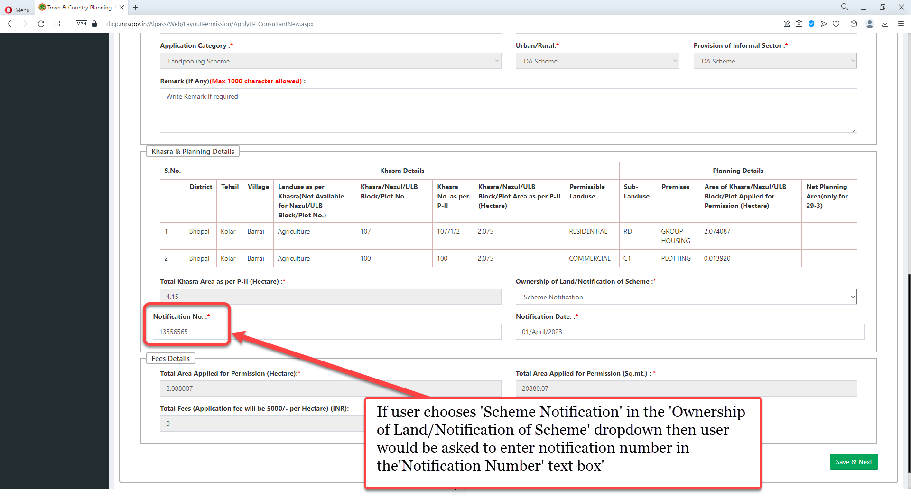
If user chooses 'Scheme Notification' in the 'Ownership of Land/Notification of Scheme' dropdown then user would be asked to enter notification number in the'Notification Number' text box'

Slide 36
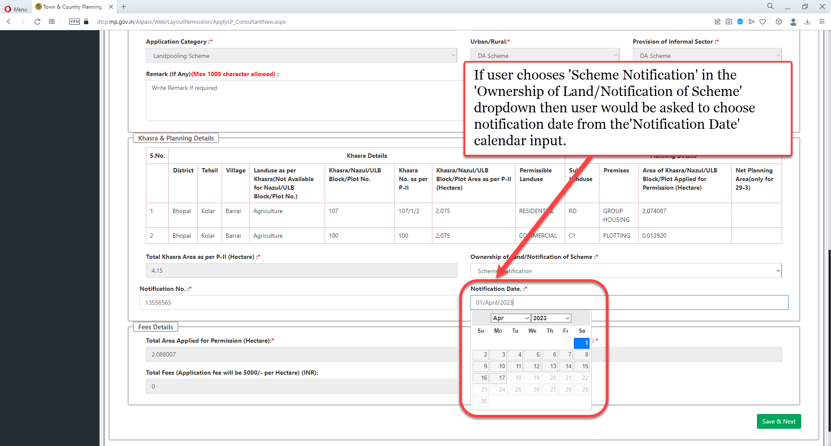
If user chooses 'Scheme Notification' in the 'Ownership of Land/Notification of Scheme' dropdown then user would be asked to choose notification date from the 'Notification Date' calendar input

Slide 37
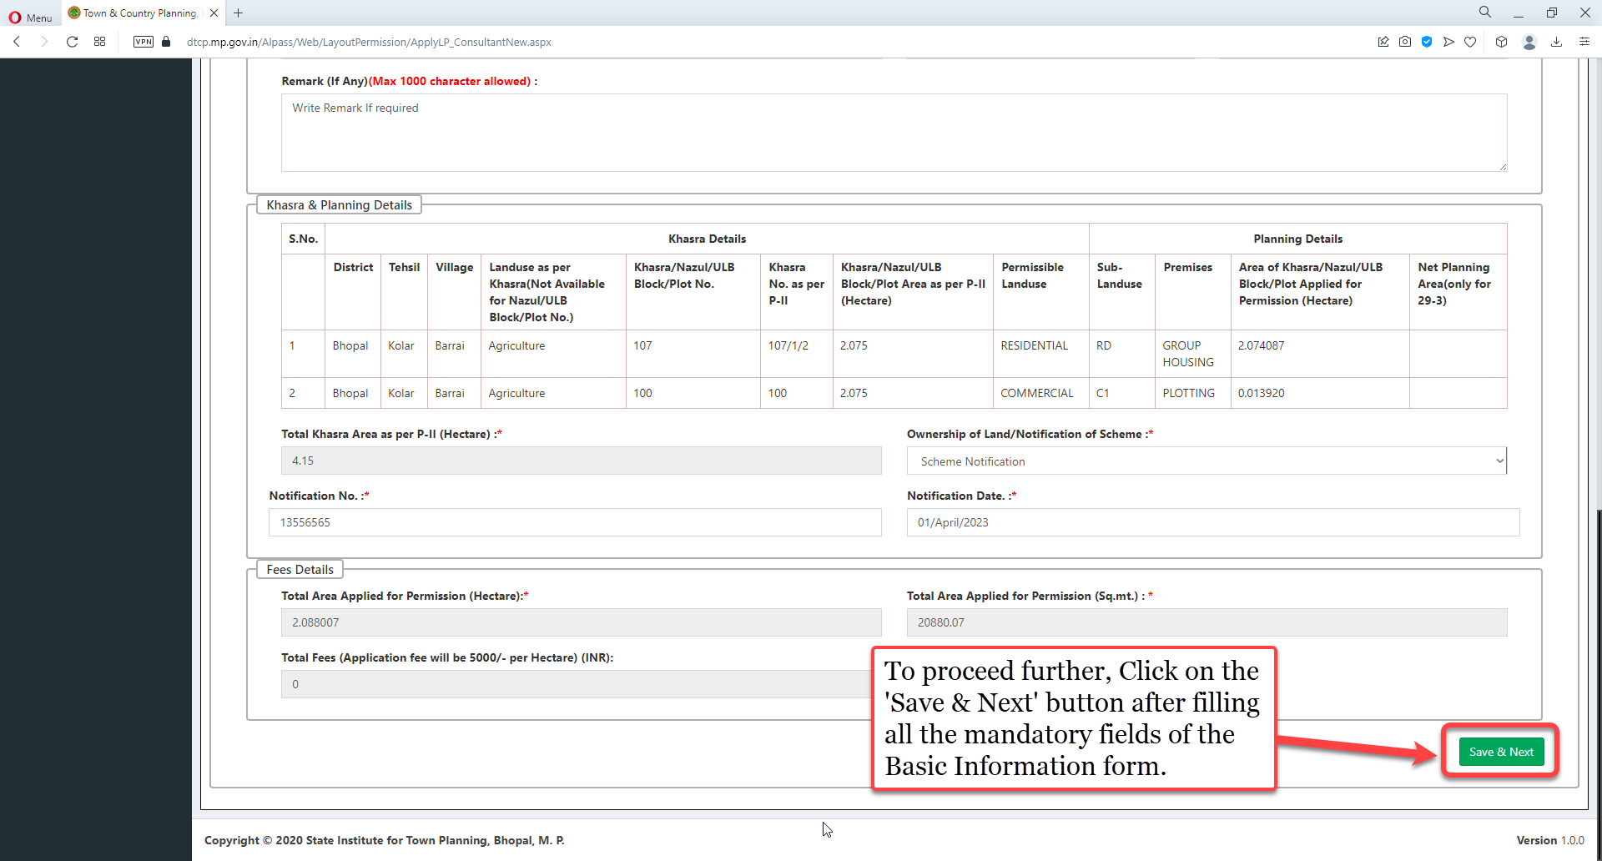
To proceed further, click on the 'Save & Next' button after filling all the mandatory fields of the Basic Information form

Slide 38
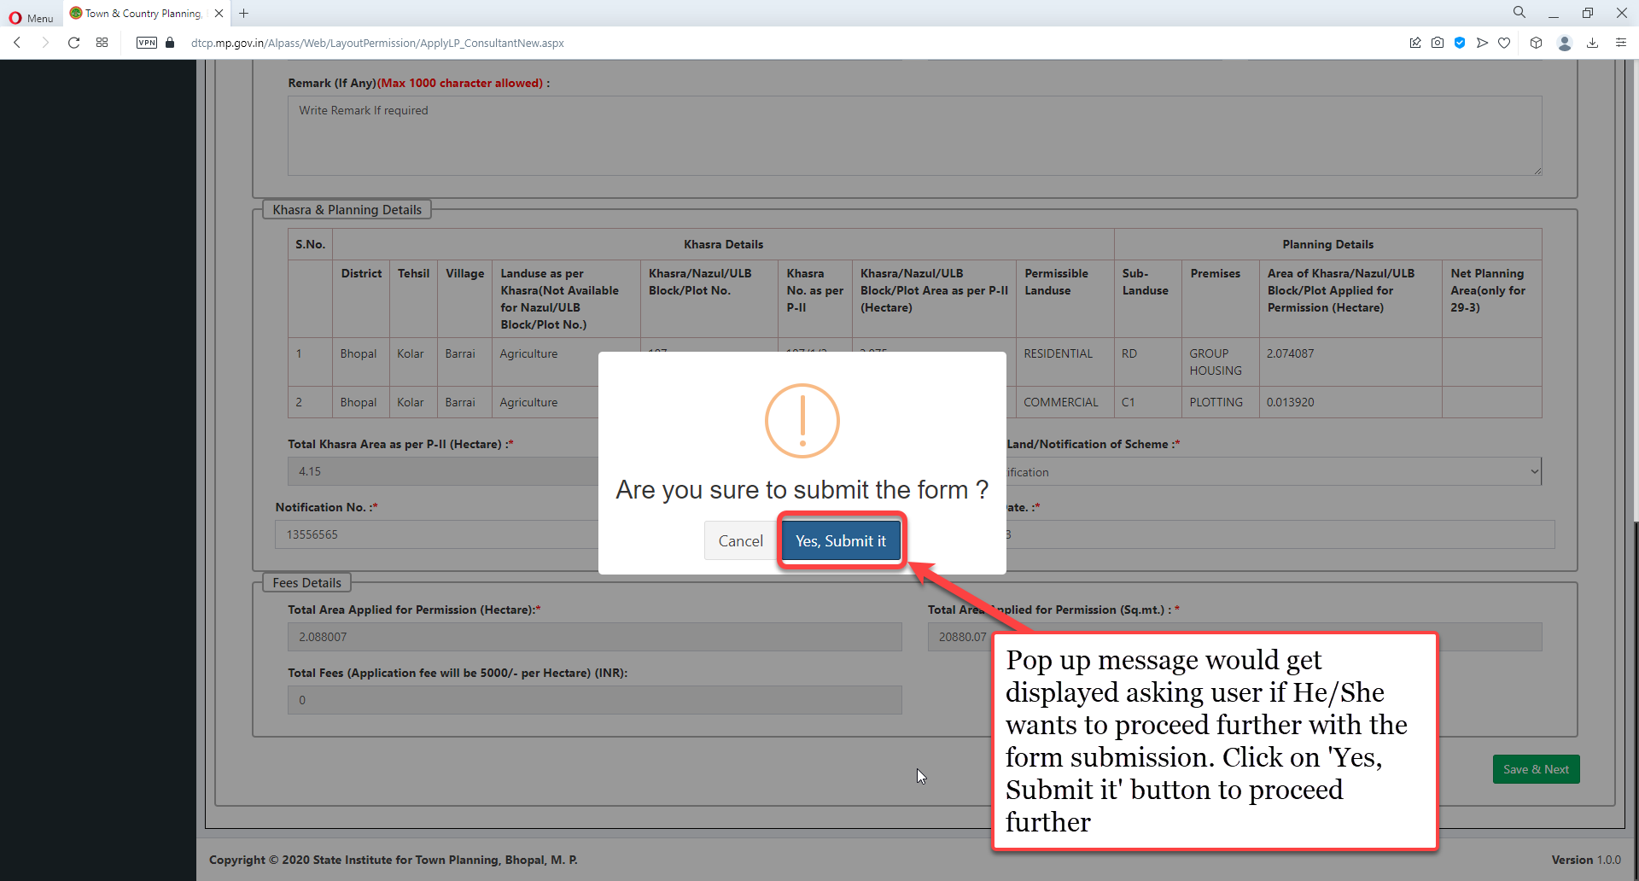
Pop up message would get displayed asking user if He/she wants to proceed further with the form submission. Click on 'Yes, submit it' button to proceed further.

Slide 39
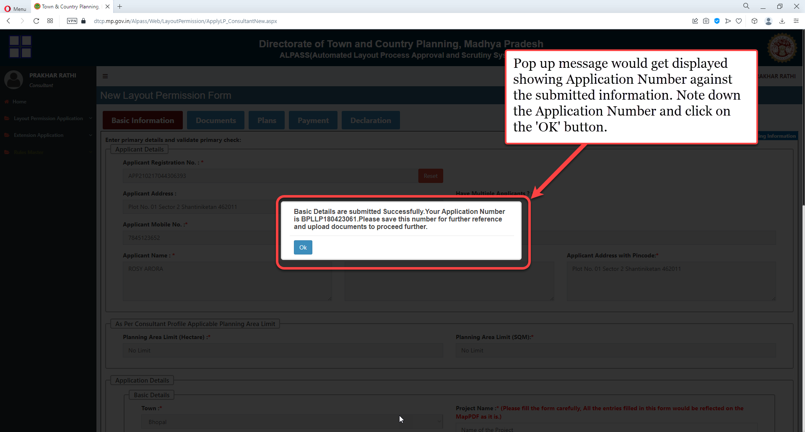
Pop up message would get displayed showing Application Number against the submitted information. Note down the Application Number and click on the 'OK' button.

Slide 40
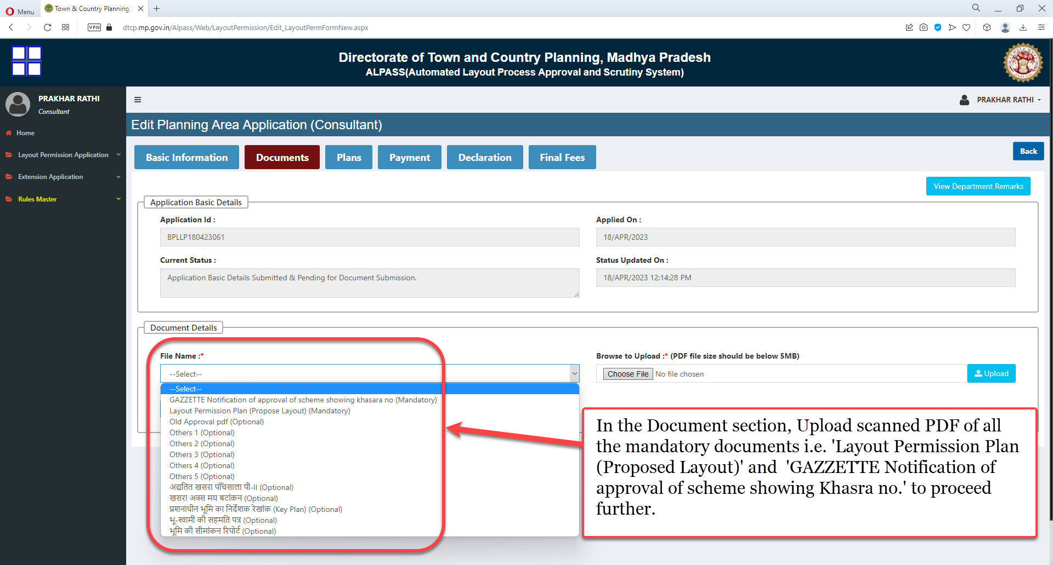
In the Document section, Upload scanned PDF of all the mandatory documents i.e. 'Layout Permission Plan (Proposed Layout)' and 'GAZZETTE Notification of approval of scheme showing Khasra no.' to proceed further

Slide 41
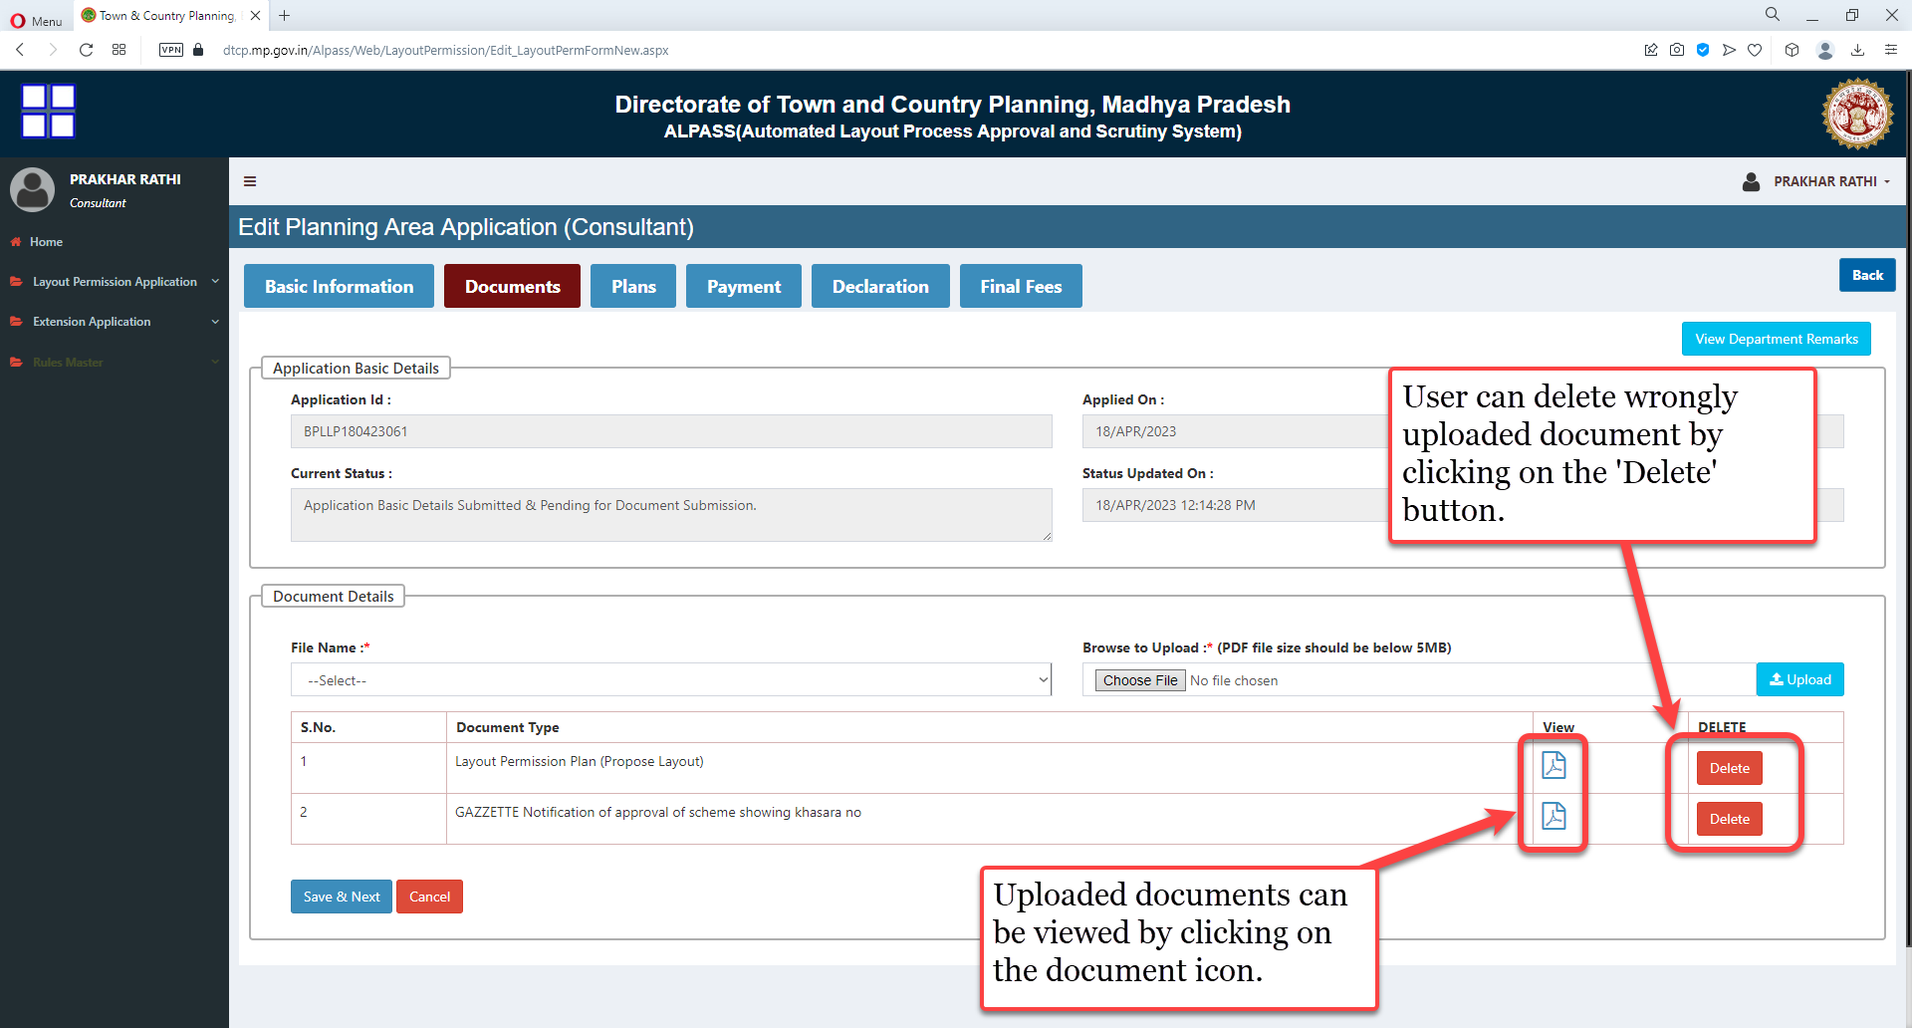
User can delete wrongly uploaded document by clicking on the 'Delete' button. Uploaded documents can be viewed by clicking on the document icon

Slide 42
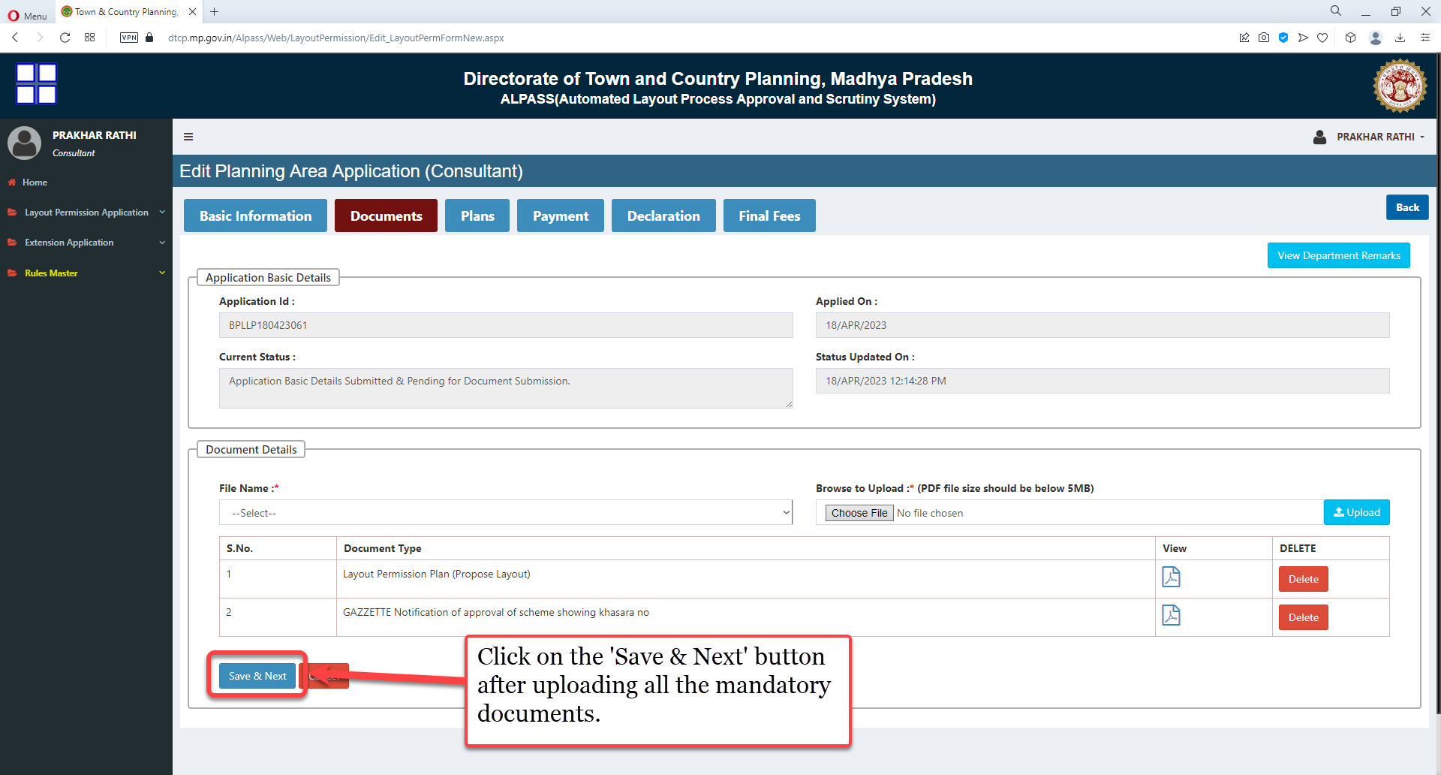
Click on the 'Save & Next' button after uploading all the mandatory documents

Slide 43
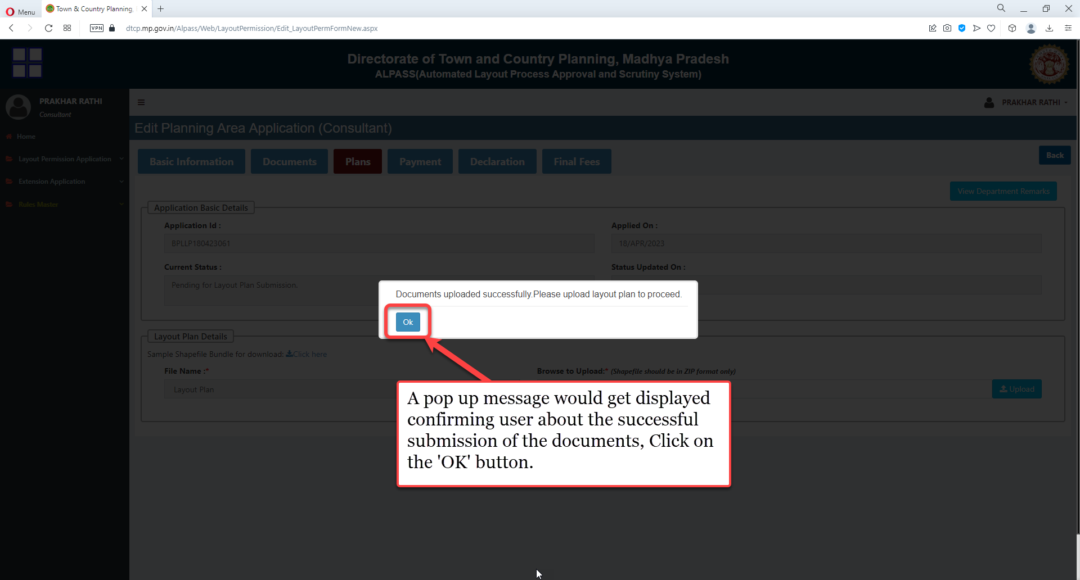
A pop-up message would get displayed confirming user about the successful submission of the documents, Click on the 'OK' button.

Slide 44
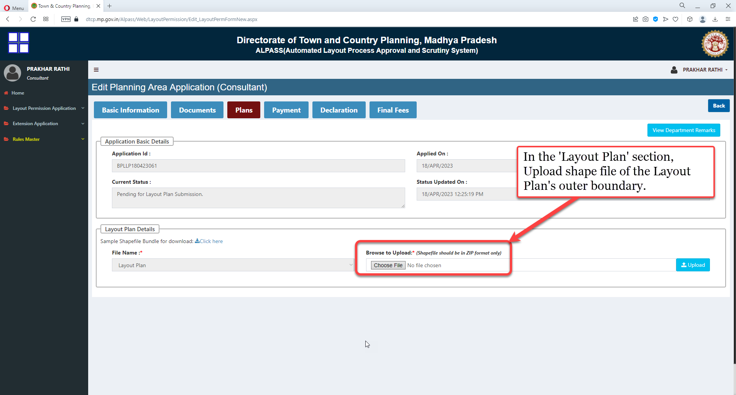
In the 'Layout Plan' section, Upload shape file of the Layout Plan's outer boundary

Slide 45
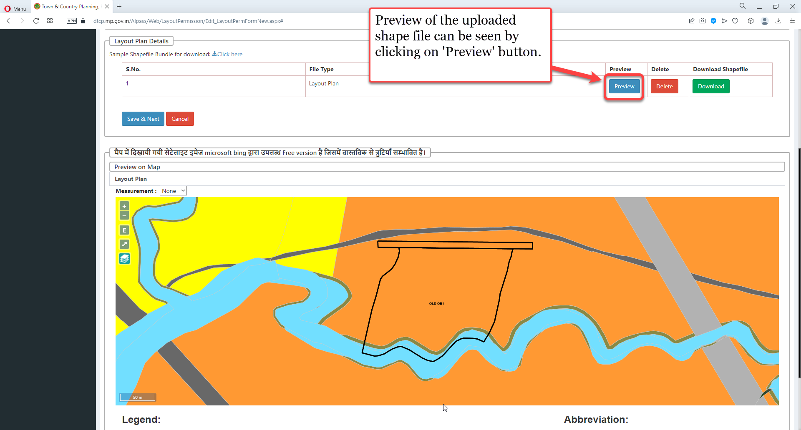
Preview of the uploaded shape file can be seen by clicking on 'Preview' button

Slide 46
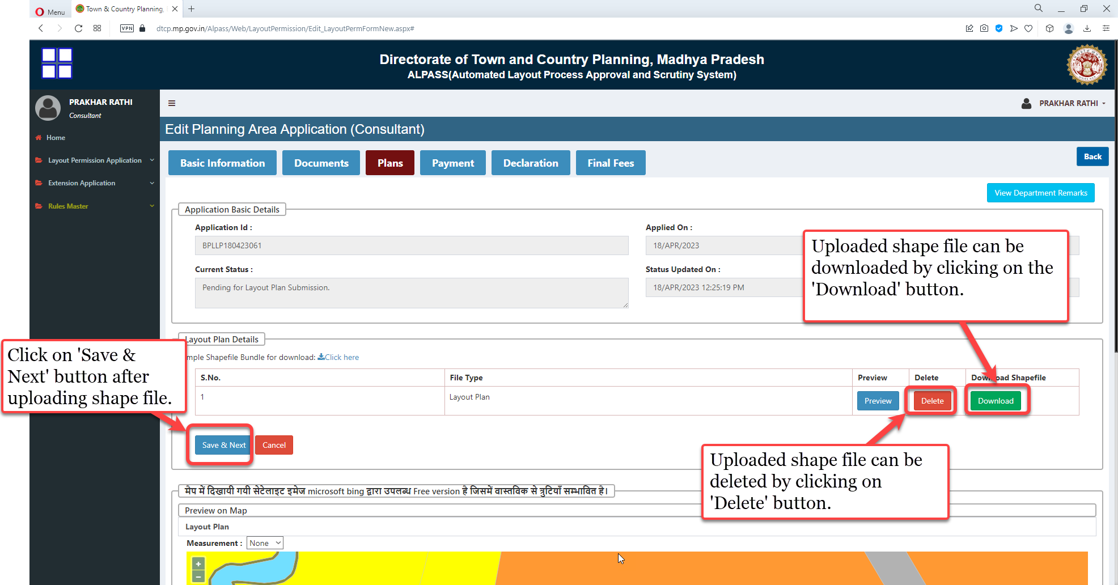
Uploaded shape file can be downloaded by clicking on the 'Download' button.
Uploaded shape file can be deleted by clicking on 'Delete' button.
Click on 'Save & Next' button after uploading shape file

Slide 47
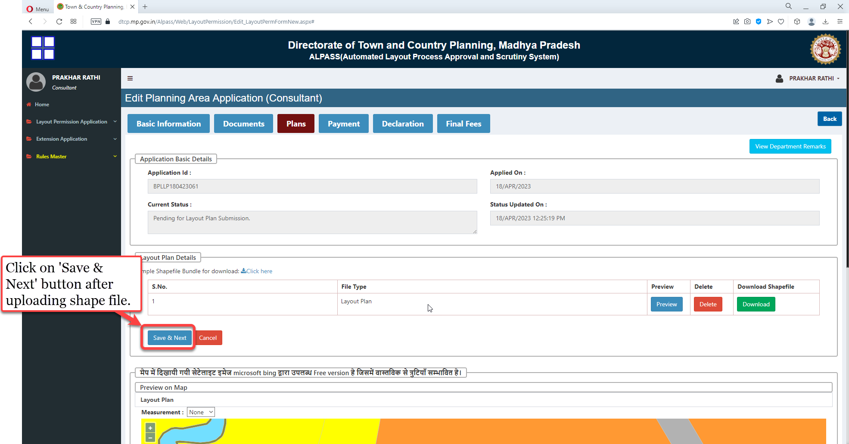
Click on 'Save & Next' button after uploading shape file

Slide 48
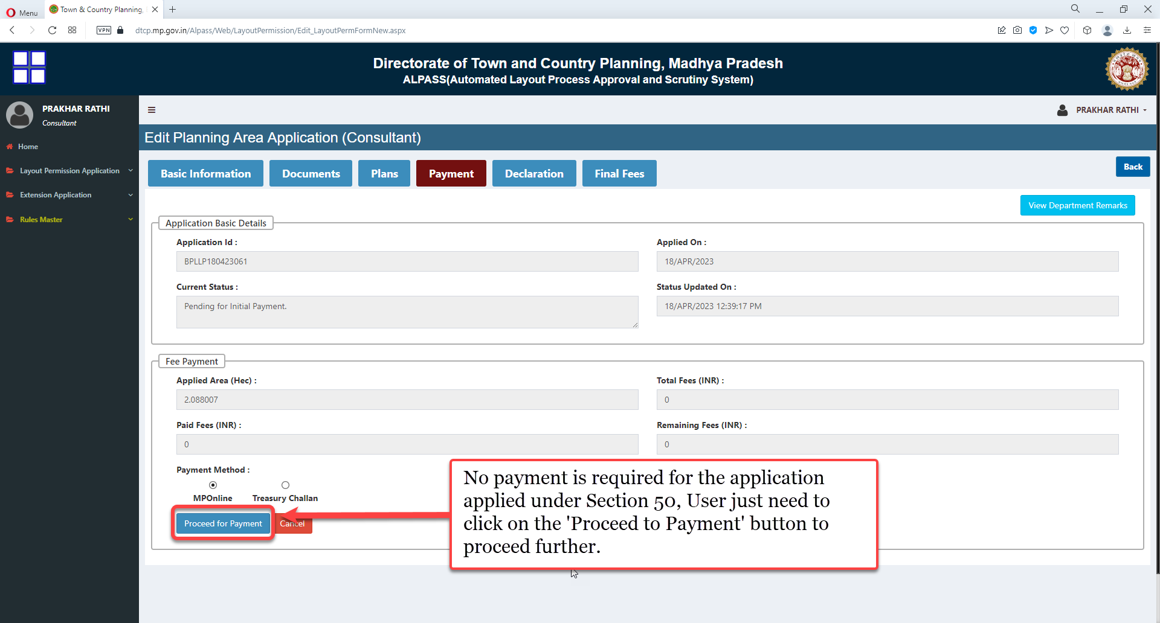
No payment is required for the application applied under Section 50, User just need to click on the 'Proceed to Payment' button to proceed further

Slide 49
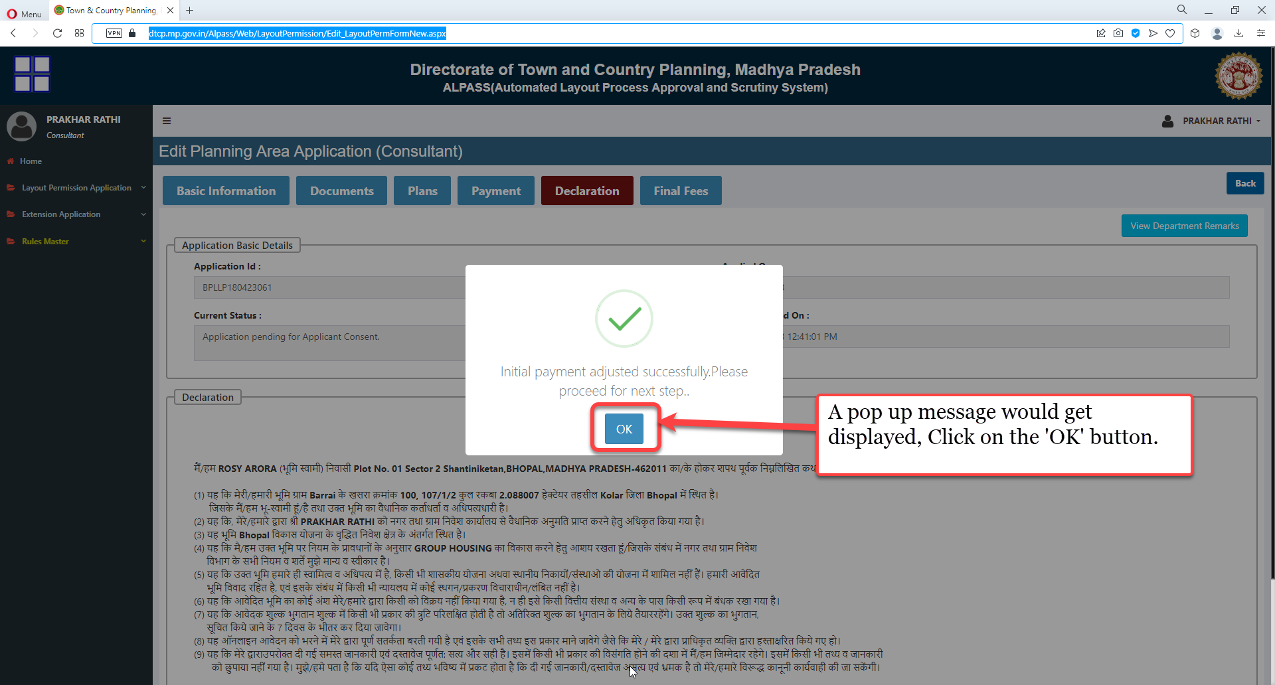
A pop up message would get displayed, Click on the 'OK' button

Slide 50
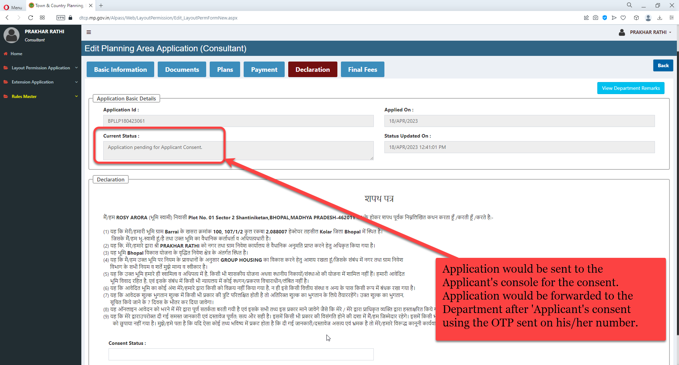
Application would be sent to the Applicant's console for the consent. Application would be forwarded to the Department after 'Applicant's consent using the OTP sent on his/her number.

